Slide 1

Utilizing data to drive care coordination of frequent users of medical transports and emergency departments
Allison Infinger, MSPH and Karen Pelletier, MSW

Slide 2

Utilizing data to drive care coordination of frequent users of medical transports and emergency departments
Allison Infinger and Karen Pelletier
About the Presenters
Allison Infinger, MSPH is a quality improvement analyst with Mecklenburg EMS Agency in Charlotte, NC.
Karen Pelletier, MSW is the business manager with Community Support Services for Mecklenburg County Government in Charlotte, NC.
Neither presenter has any conflicts of interest to disclose.

Slide 3
Utilizing data to drive care coordination of frequent users of medical transports and emergency departments
Allison Infinger and Karen Pelletier
Session Objectives
Share and utilize data in determining individuals who most frequently access emergency medical care via emergency transports (9-1-1).
Identify and engage key stakeholders from across public and private systems.
Understand the importance of continued engagement of key stakeholders is fundamental to coordinating care efforts and sustaining significant decreases of non-emergency transports.

Slide 4
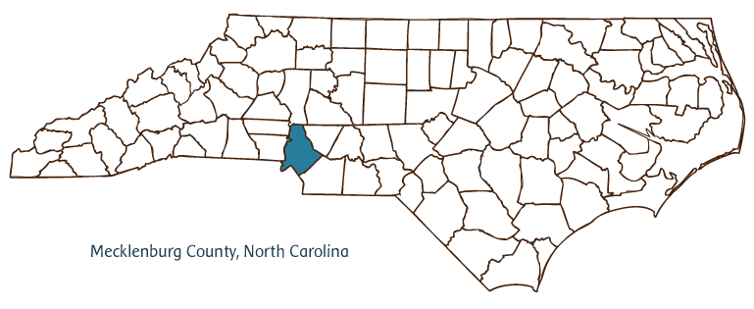
Utilizing data to drive care coordination of frequent users of medical transports and emergency departments
Allison Infinger and Karen Pelletier

Slide 5
Utilizing data to drive care coordination of frequent users of medical transports and emergency departments
Allison Infinger and Karen Pelletier
Our Program
Fee-for-service vs.
value-based service model
Patient-centered
Collaborative

Slide 6
Utilizing data to drive care coordination of frequent users of medical transports and emergency departments
Allison Infinger and Karen Pelletier
FRAMEWORK
Determine Scope of Problem
Identify & Engage
Develop & Implement Process
Monitor & Assess

Slide 7
Utilizing data to drive care coordination of frequent users of medical transports and emergency departments
Allison Infinger and Karen Pelletier
Scope of Problem
High Frequency Users
3430 patients
N=20 215 (20.0%)
Super User
20 patients
N=1 155 (5.7%)
Care plan
3 patients
N=265 (22.9%)
Total transports in 2015
N=101 101

Slide 8
Utilizing data to drive care coordination of frequent users of medical transports and emergency departments
Allison Infinger and Karen Pelletier
Who is a frequent user?
Definition: all patients transported at a rate of ≥ 1.0 over four consecutive months
Needs:
Medical
Psychiatric/Substance Use
Social
Experiencing Homelessness
Inappropriate level of care
Managing chronic illness

Slide 9
Utilizing data to drive care coordination of frequent users of medical transports and emergency departments
Allison Infinger and Karen Pelletier
Who is a super user?
Number of patients | N=20
Age (mean, range) | 50.65 (27-67)
Gender (n, %)
Male | 15 (75%)
Female | 5 (25%)
Race
White or Caucasian | 12 (60%)
Black or African American | 8 (40%)

Slide 10
Utilizing data to drive care coordination of frequent users of medical transports and emergency departments
Allison Infinger and Karen Pelletier
Who is a super user?
Complaints | Primary | Secondary
OD/Ingestion | 35% | 10%
Breathing Problems | 10% | 10%
Psychiatric Problems | 20% | 5%
Chronic Pain | 10% | 40%
Homelessness | 0% | 25%
Other | 25% | 10%

Slide 11
High Frequency Patient
Mecklenburg EMS Agency
Charlotte Mecklenburg Police Department
Charlotte Housing Authority
Homeless Service Providers
Behavioral Health Charlotte
Cardinal Innovations (LME)
Department of Social Services
Hospital Systems
Community Support Services
Community Care Partners of Greater Mecklenburg

Slide 12

Utilizing data to drive care coordination of frequent users of medical transports and emergency departments
Allison Infinger and Karen Pelletier

Slide 13
Utilizing data to drive care coordination of frequent users of medical transports and emergency departments
Allison Infinger and Karen Pelletier
Quality Improvement
External referral
Manager
Empirically determined
Supervisor
Employee
Development & Implementation

Slide 14
Utilizing data to drive care coordination of frequent users of medical transports and emergency departments
Allison Infinger and Karen Pelletier
Identification
Patient is identified and sent up through appropriate chain of command
Patient is forwarded to QI for analysis
Approval
QI assigns a transport volume score
QI forwards patient information for subjective assessment by the Medical Director and Assistant Medical Director for urgency score
Referral
Approved: QI will refer patient to Super User list with the county and follow-up with referring party
Not approved: QI will follow-up with referring party

Slide 15
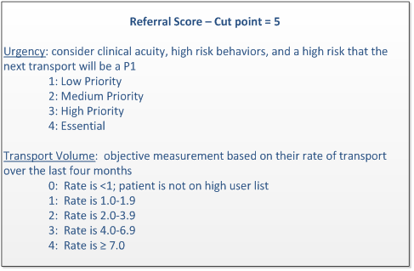

Slide 16
Utilizing data to drive care coordination of frequent users of medical transports and emergency departments
Allison Infinger and Karen Pelletier
Development and Implementation
Set a schedule
Agree upon joint expectations
Establish data sharing agreements
Identify necessary tools and technologies

Slide 17
Utilizing data to drive care coordination of frequent users of medical transports and emergency departments
Allison Infinger and Karen Pelletier
Monitor and Assess
Qualitative
Quantitative

Slide 21
Utilizing data to drive care coordination of frequent users of medical transports and emergency departments
Allison Infinger and Karen Pelletier
Monitor and Assess
Context of patient needs
Constant improvement
Focused updates
Sustaining engagement
Reassessing stakeholders
Adjusting time/date

Slide 22
FRAMEWORK
Determine Scope of Problem
Identify & Engage
Develop & Implement Process
Monitor & Assess

Slide 23
Utilizing data to drive care coordination of frequent users of medical transports and emergency departments
Allison Infinger and Karen Pelletier
Keys to Success
Change is a process
Identifying and responding to services gaps in timely manner
Need for social interventions
Innovative thinking
Keeping agencies engaged
Collaboration is key!

Slide 24
Utilizing data to drive care coordination of frequent users of medical transports and emergency departments
Allison Infinger and Karen Pelletier
Contact Information:
Allison Infinger – Mecklenburg EMS Agency (MEDIC)
Allison1@MEDIC911.com
704-943-6256
Karen Pelletier – Mecklenburg County Community Support Services
Karen.Pelletier2@MecklenburgCountyNC.gov
980-314-8904
@KPMSW1

