Slide 1

Lessons from Homelink:
How to Design & Implement Technology for Coordination and Collaboration
Karina Mueller
Jana Pohorelsky

Slide 2




Lessons from Homelink
Karina Mueller
Jana Pohorelsky
Welcome!
Karina Mueller Jana Pohorelsky
Senior Solutions Advisor Data & Performance Coordinator

Slide 3

Lessons from Homelink
Karina Mueller
Jana Pohorelsky
Who We Are
We work toward a future without homelessness, in which poverty never follows families beyond a single generation.
Zero: 2016
is a rigorous national change effort designed to help a committed group of US communities end chronic and veteran homelessness outright by December 2016.

Slide 4

Lessons from Homelink
Karina Mueller
Jana Pohorelsky
Technology & Process
Technology = Homelink
Process CAHP
Coordinated
Assessment &
Housing
Placement System

Slide 5

Lessons from Homelink
Karina Mueller
Jana Pohorelsky
Coordinated Assessment &
Housing Placement System
Without CAHP System With CAHP System

Slide 6
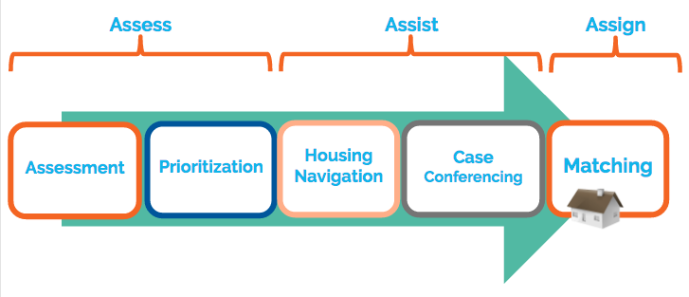
Lessons from Homelink
Karina Mueller
Jana Pohorelsky
Core Components of a CAHP System

Slide 7

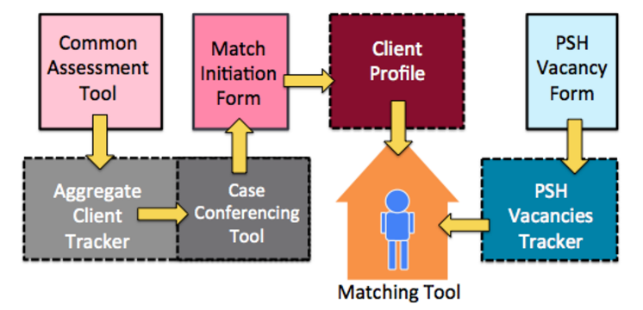
Lessons from Homelink
Karina Mueller
Jana Pohorelsky
Before Homelink...there was PMCP
Performance Management and Communications Platform
Client-side data: VI-SPDAT and Match Initiation Form populate Client Profile
Housing-side data: Vacancy Tracker
Matching Tool

Slide 8
Lessons from Homelink
Karina Mueller
Jana Pohorelsky
Challenges with PMCP
Broke the Google!
Capacity limitations led to system slowness
PII data had to be stored and updated separately
Precariousness of formulas resulted in time-consuming corrections

Slide 9
Lessons from Homelink
Karina Mueller
Jana Pohorelsky
Which Brings us to Homelink
Developed in partnership with the philanthropy division of Palantir Technologies
Created in January 2015
Secure, HIPAA-compliant, user-friendly, web-based
3 Platforms: matching interface, user-friendly data analytics, and backend data management tool
6 user roles with varying levels of permission:
Form Entry, Navigator, Coordinator, Matcher, Housing Provider, Superuser

Slide 10
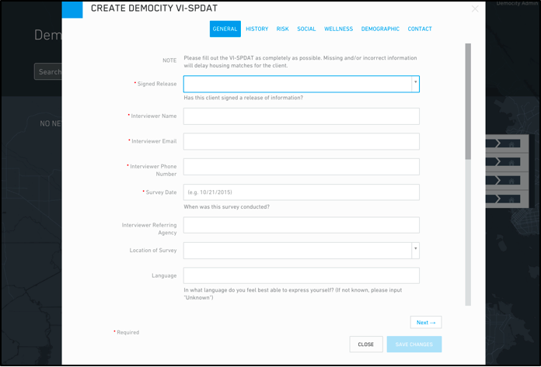
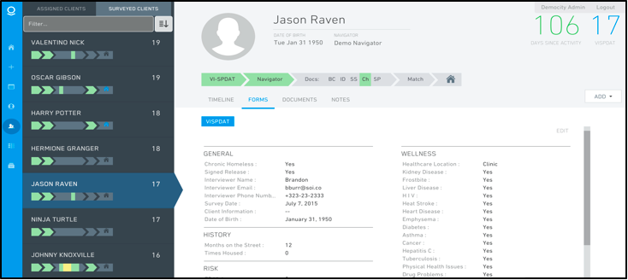
Lessons from Homelink
Karina Mueller
Jana Pohorelsky
Assess

Slide 11
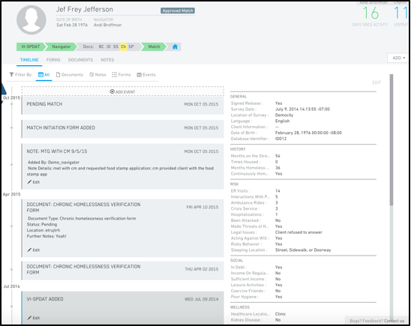
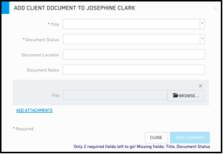
Lessons from Homelink
Karina Mueller
Jana Pohorelsky
Assist

Slide 12
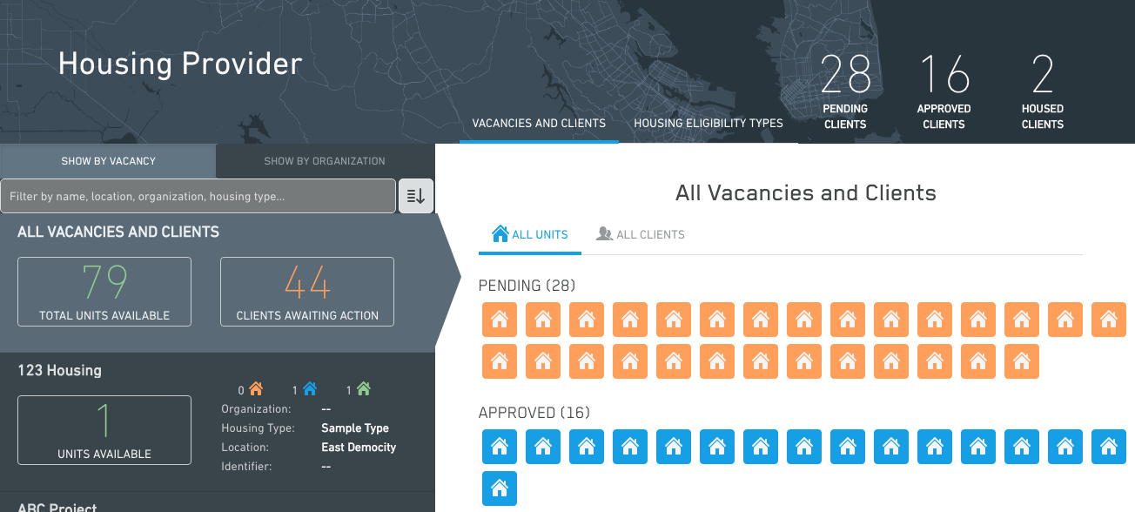
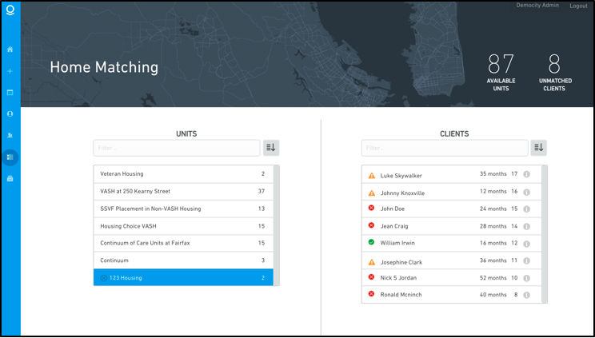
Lessons from Homelink
Karina Mueller
Jana Pohorelsky
Assign

Slide 13
Lessons from Homelink
Karina Mueller
Jana Pohorelsky
In Action!

Slide 14

Lessons from Homelink
Karina Mueller
Jana Pohorelsky
Homelink Communities
January 2015
October 2016
Bakersfield/Kern County
Chattanooga/Southeast TN
Columbus/Russell County
Connecticut
Fresno/Madera County
Honolulu
Jackson/Rankin/Madison
Lancaster City
Nashville
Norman/Cleveland
Philadelphia
Phoenix
Riverside
San Francisco
Santa Maria/Santa Barbara
Springfield
Memphis
Cape Cod
Denver
Bakersfield/Kern County
Fargo
Denver
Fresno/Madera County
Honolulu
Nashville
Phoenix
Riverside
San Francisco
Springfield

Slide 15
Lessons from Homelink
Karina Mueller
Jana Pohorelsky
Adoption Challenges
Technology systems require significant buy-in and change management, especially when they are not mandatory
Difficulty implementing a new Release of Information (ROI)
Lack of understanding around what a CAHP entails and challenges in implementing this system outside of Homelink: Building the (CAHP) plane while flying it
Counting on Homelink to be the “silver bullet”
Few people using Homelink outside of leadership point of contact
Concerns about double-data entry with HMIS
Completely free system meant that communities had less of an incentive to overcome challenges & barriers

Slide 16
Lessons from Homelink
Karina Mueller
Jana Pohorelsky
Conditions for Successful Adoption
When the community had built a coordinated assessment and housing placement system including staff, policies and procedures, they fit easily into user roles provided by Homelink
CoC Involvement is helpful (and sometimes critical) to seeing coordinated efforts come to fruition
In-person training and consistent ongoing support, including check-ins to focus on the community’s CAHP process
Considering a checklist of criteria required prior to Homelink onboarding, in order to set the community up for successful adoption

Slide 17
Lessons from Homelink
Karina Mueller
Jana Pohorelsky
Implementing a Pre-Onboarding Checklist
Map the current state of the community’s CAHP system
Understand the current, non-technology challenges in the community’s current CAHP system
Identify all stakeholders in the community: CoC, Community Leadership teams, direct service providers, housing providers, VA, etc.
Review community’s current policies & procedures
Gain buy-in prior to onboarding
Ensure ROI has been solidified and/or modified for Homelink user

Slide 18
Lessons from Homelink
Karina Mueller
Jana Pohorelsky
Summary of Lessons Learned
Prework to onboarding is essential
Understanding and developing the underlying process that the technology supports, is critical
Choosing an agile, values-based technology partner is key

Slide 19
Lessons from Homelink
Karina Mueller
Jana Pohorelsky
On Choosing a Technology Partner:
It’s not just a partnership, it’s a relationship
Understand how the company operates;
what are their values, what do they believe in?
what is their staff turnover like? will there be continuity of project management & staffing?
how do they make decisions? how will decision be made within the partnership?
what is their business model?
how much emphasis is placed on customer satisfaction? how do current and past customers rate their experience?
What are the expectations? What do we hope to achieve and by when?
What is the ultimate goal of the system?
How will success be measured?
How agile are we going to be? How much will it cost to adapt to change?
Roles, responsibilities, and complementary knowledge and expertise

Slide 20
Lessons from Homelink
Karina Mueller
Jana Pohorelsky
Thank you!
Questions?

