Slide 1
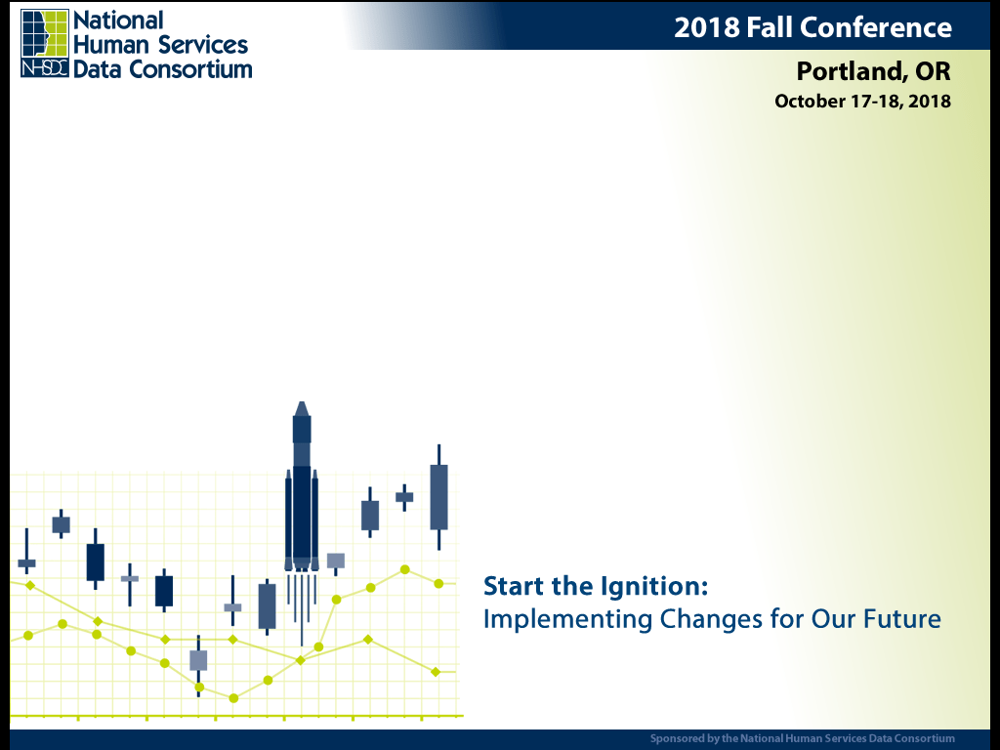
Linking Housing Program and Social Service Data to Improve Client Services
Webb Sprague
Chris Albrecht
Taylor Danielson
Talia Scott

Slide 2
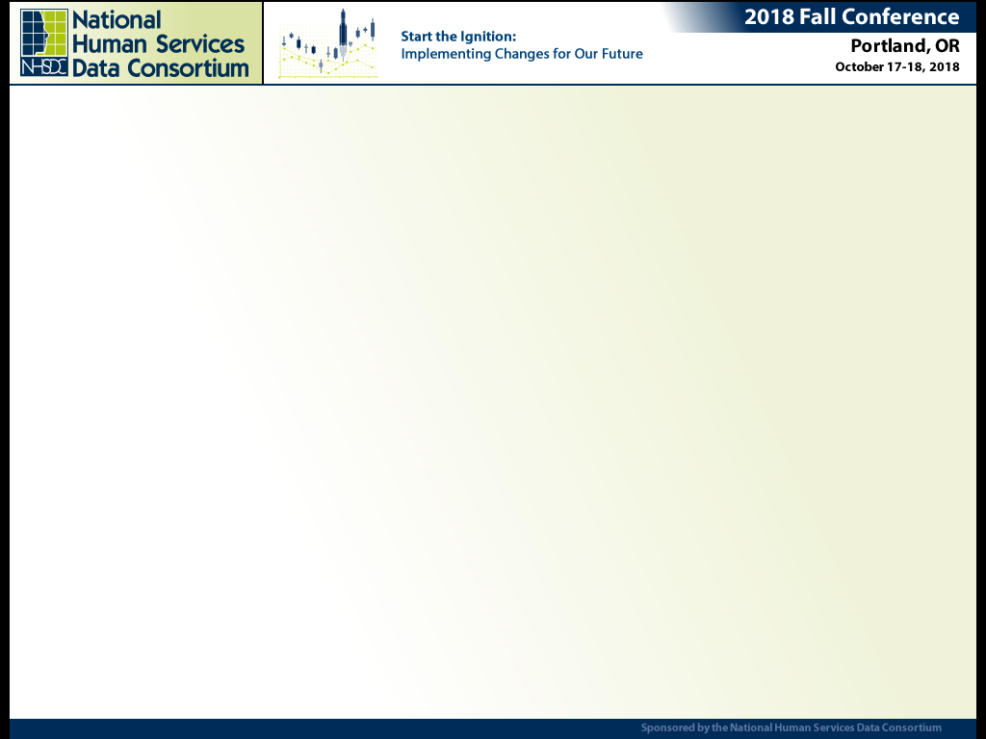


Linking Housing Program and Social Service Data to Improve Client Services
Presenter’s Affiliations

Slide 3

Introduction by Talia
Linking Housing Program and Social Service Data to Improve Client Services
Talia Scott
BREAKING
NERD
ALERT
Getty Images/iStock

Slide 4
Overview of Presentation
Linking Housing Program and Social Service Data to Improve Client Services
Talia Scott
Complicated system, will take a lot to give a picture:
Overview of RDA data infrastructure (Webb)
How HMIS data fits into RDA (Chris)
Some cool products over the last 8 years (Taylor)
Thoughts on the RDA / Commerce partnership (Talia)

Slide 5

Department of Commerce and RDA
Linking Housing Program and Social Service Data to Improve Client Services
Talia Scott
History of partnership
Interagency Agreement 2010-now
Began with HPRP Study
Dollars
Getty Images/iStock

Slide 6
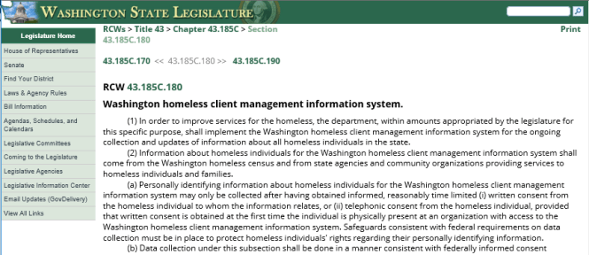
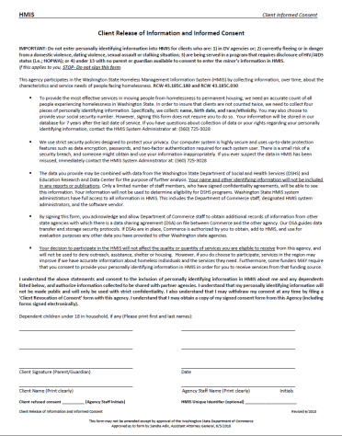
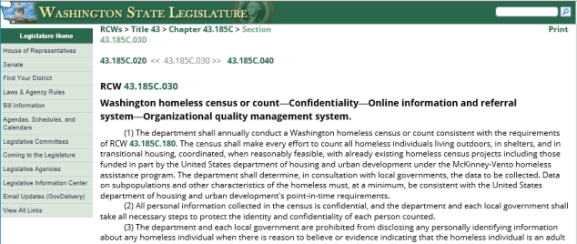
HMIS State Laws and Consent
Linking Housing Program and Social Service Data to Improve Client Services
Talia Scott
WA HMIS
WA homeless census or count system (aka PIT)
WA HMIS Informed Consent Form

Slide 7
RDA data infrastructure
Linking Housing Program and Social Service Data to Improve Client Services
Webb Sprague

Slide 8
Linking Housing Program and Social Service Data to Improve Client Services
Webb Sprague
Why administrative data?
ADMINISTRATIVE DATA are data that already exist in the record.
Every time a person interacts with a government entity a record is generated.
In time, thousands of records can be created.
These records can be linked together to tell a person’s story over time.
Birth Certificate
Out-of-Home Placement
Emergency Shelter
Emergency Department
SUD Treatment
Employment
PERSON
#XX,XXX
PERSON
#XX,XXX
PERSON
#XX,XXX
PERSON
#XX,XXX
PERSON
#XX,XXX
PERSON
#XX,XXX

Slide 9
Linking Housing Program and Social Service Data to Improve Client Services
Webb Sprague
What are integrated data?
INTEGRATED DATA is data from hundreds of thousands of individuals that is made confidential, secured in a safe environment, and aggregated to better understand outcomes and risks, improve programs, and inform decisions.
2013
2014
2015
2016
2017
Record
x 1,000s
x 100,000s
PERSON
#XX,XXX

Slide 10
Linking Housing Program and Social Service Data to Improve Client Services
Webb Sprague
What makes it so complex?
For every person receiving services, hundreds of records can be tracked every year.
Millions of people generate millions and millions of records over time.
Systems that hold this data and keep it secure are large and complex.
The people who program these systems must be technologically adept and have years of experience.
Researchers who work with this information must be policy savvy, subject matter experts, and very good at statistics.
For example . . .

Slide 11
Linking Housing Program and Social Service Data to Improve Client Services
Webb Sprague
In a single year, a single client can have many records
We align the records of millions of people a year over decades of service.
This allows us to see the relationship between homelessness and other social and health issues.
 | 2018
PROGRAM SERVICES | JAN | FEB | MAR | APR | MAY | JUN | JUL | AUG | SEP | 0CT | NOV | DEC
Child Welfare Case Management
Child Protective Services Case Management
Foster Care Services
Family Focused Services
Family Voluntary Services Case Management
Substance Abuse Services
Economic Services
Medical Assistance
Mental Health Services
CLIENT INDICATORS
Substance Abuse Treatment Need
Homeless without Housing
Homeless with Housing
Homelessness (Any type)
Emergency Department Visit – Outpatient
Emergency Department Visit – Inpatient
Medical – Injury
Diagnosis of Depression
Diagnosis of Anxiety
Diagnosis of Adjustment and Stress Disorder
Diagnosis of Alcohol Use Disorder
Diagnosis of Drug Use Disorder
Inpatient Mental Health Treatment Stay
Assault Charges
Arrest
Alcohol/Drug Charge
Misdemeanor Charge
Felony Conviction
Incarceration
Millions of People a Year
Decades of Services

Slide 12
Linking Housing Program and Social Service Data to Improve Client Services
Webb Sprague
In Washington State, we have aligned over 60 data sources
DATA SOURCES
Department of Social and Health Services | Washington State Health Care Authority | Department of Children, Youth and Families | Other State and Federal Entities
Aging and Long-Term Support Nursing Facilities In-home Services Community Residential Functional Assessments Behavioral Health Child Study Treatment Center State Hospitals Developmental Disabilities Case Management Community Residential Services Personal Care Support Residential Habilitation Centers and Nursing Facilities Economic Services Food Stamps TANF and State Family Assistance General Assistance Child Support Services Working Connections Child Care Vocational Rehabilitation Medical and Psychological Services Training, Education, Supplies Case Management Vocational Assessments Job Skills | Behavioral Health Assessments Detoxification Outpatient Treatment Residential Treatment Opiate Substitution Treatment Children’s Long-term Inpatient Program Community Inpatient Evaluation/Treatment Community Services Hospital Inpatient/Outpatient Managed Care Prescription Drugs | Child Welfare Services Child Protective Services Child Welfare Services Family Reconciliation Services Adoption Adoption Support Child Care Out of Home Placement Voluntary Services Early Learning Services Juvenile Rehabilitation (Set to transfer from DSHS July 1, 2019) Institutions Dispositional Alternative Community Placement Parole | Administrative Office of the Courts Charges Convictions Department of Corrections Incarcerations Community Supervision Department of Health Births Deaths Employment Security Department Hours Wages Department of Commerce Housing Assistance Emergency Shelter Transitional Housing Homeless Prevention and Rapid Re-housing Permanent Supportive Housing Washington State Patrol Arrests

Slide 13



















Linking Housing Program and Social Service Data to Improve Client Services
Webb Sprague
Our ability to do this work is the result of …
Decades of experience working with integrated data (we started almost 50 years ago) and strategic partners in the state and private sector.
A sustained vision over time and a constant funding stream.
A smart and talented team of researchers, with highly technical skills and wide-ranging subject matter expertise.
Now we have a steady flow of research studies and other products going out the door on a daily basis.

Slide 14
HMIS data support
Linking Housing Program and Social Service Data to Improve Client Services
Chris Albrecht

Slide 15

HMIS Data Support
Linking Housing Program and Social Service Data to Improve Client Services
Chris Albrecht
Provides HMIS data support by designing a robust data system for data analysis purposes
Integrates various HMIS data sources into a normalized database
For quality assurance
For easier queries
Getty Images/iStock

Slide 16

HMIS Data Warehouse
Linking Housing Program and Social Service Data to Improve Client Services
Chris Albrecht
Transforms several different data formats and software packages into a single database
Collaborates closely with multiple HMIS vendors on various data quality issues
Assisted in the transition of legacy data between vendors
Helps fulfil state law requiring statewide HMIS data warehouse RCW 43.185c.180
Getty Images/iStock

Slide 17

Supporting Commerce’s Mission
Linking Housing Program and Social Service Data to Improve Client Services
Chris Albrecht
Created a dynamic web-based application to track clients’ outcomes
Integrates HMIS data of counties not currently in the Vendor’s database for a more complete HMIS database
Assists in ad hoc requests of data for specific HMIS providers and reports
Getty Images/iStock

Slide 18

Process for Linking HMIS into RDA Data Environment
Linking Housing Program and Social Service Data to Improve Client Services
Chris Albrecht
Utilize SAS statistical software for data analysis, quality assurance, and reporting
Use SAS Link King program for deduplication of HMIS clients and for linking other RDA data sources with HMIS
Direct VPN connection to vendor’s live data
Getty Images/iStock

Slide 19
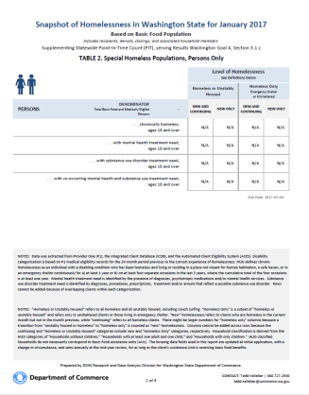
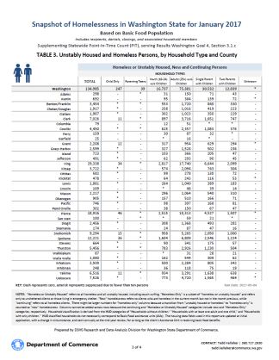
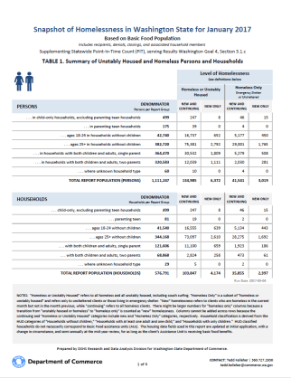
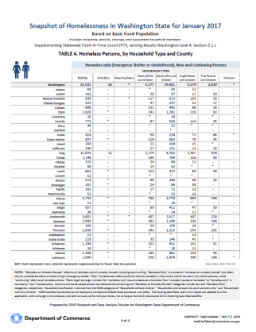
Supplemental Point-in-Time Count
Linking Housing Program and Social Service Data to Improve Client Services
Chris Albrecht

Slide 20

Q. Does anyone work with TANF MOE?
Linking Housing Program and Social Service Data to Improve Client Services
Getty Images/iStock

Slide 21
Supporting TANF Federal Reporting
Linking Housing Program and Social Service Data to Improve Client Services
Chris Albrecht
RDA calculates the federal matching dollars for TANF Maintenance of Effort (MOE)
Matches HMIS clients to DSHS client demographic information to determine who is MOE qualified
Find state funded HMIS dollars spent on matched clients
Add state funded HMIS dollars to TANF MOE claim

Slide 22
Collaborative Research
Linking Housing Program and Social Service Data to Improve Client Services
Taylor Danielson

Slide 23
Identifying Homeless and Unstably Housed DSHS Clients in Multiple Service Systems (2012)
Linking Housing Program and Social Service Data to Improve Client Services
Taylor Danielson
All Ages
TOTAL = 1,946,302
Children Age 0-17
Working Age 18-64
As identified
in multiple systems
+27%
As identified
in multiple systems
+35%
As identified
in multiple systems
+25%
As identified by ACES only
As identified by ACES only
As identified by ACES only
n = 184,865
n = 145,598
n = 39,787
n = 29,572
n = 142,396
n = 113,707
https://www.dshs.wa.gov/sesa/rda/research-reports/identifying-homeless-and-unstably-housed-dshs-clients-multiple-service-systems
Notes:
Data from multiple systems can also be used to develop better estimates of homelessness (note that HMIS participation was lower prior to HPRP being implemented in 2010)
An RDA researcher used information from HMIS, economic services data, mental health records, chemical dependency records, and medical records to identify homeless clients.
Based on this information, she found that the homelessness rate was 27% higher than if we had based it on economic services data alone.
Furthermore, the data indicate that this increase in the homelessness rate differed across various groups.
For example, homelessness was 35% higher for children, 25% higher for adults age 18-64, and 16% higher for seniors age 65 or older.

Slide 24
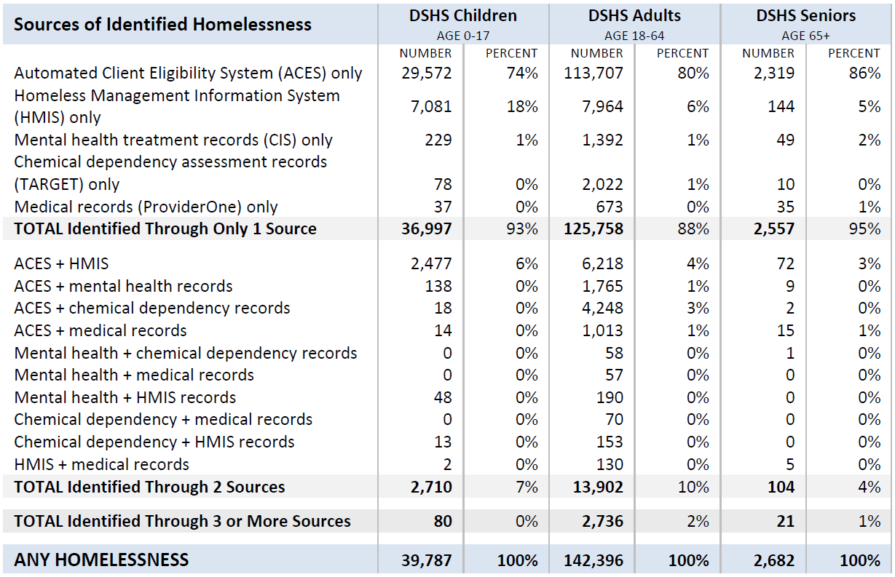
Linking Housing Program and Social Service Data to Improve Client Services
Taylor Danielson
Data Sources
https://www.dshs.wa.gov/sesa/rda/research-reports/identifying-homeless-and-unstably-housed-dshs-clients-multiple-service-systems

Slide 25
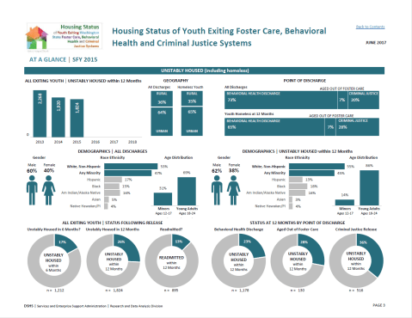
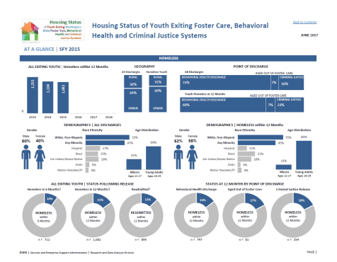
Housing Status of Youth Exiting Foster Care, Behavioral Health and Criminal Justice Systems
Linking Housing Program and Social Service Data to Improve Client Services
Taylor Danielson
https://www.dshs.wa.gov/sites/default/files/SESA/rda/documents/research-11-240.pdf
Notes:
Bringing data together from multiple source systems not only allows us to support the state’s operational activities and refine our homelessness counts but also to help our program partners to identify:
Who their clients are,
What types of state services they have received,
Which systems of care these clients have exited from
Also allow us to look at trends over time.

Slide 26
Housing Status of Youth Exiting Foster Care, Behavioral Health and Criminal Justice Systems
Linking Housing Program and Social Service Data to Improve Client Services
Taylor Danielson
Housing Status in 12-Month Follow-up Period
Service Systems in which Homeless is Identified
Among Homeless Youth Aging Out of Foster Care (n = 396)
Homeless
or Unstably Housed
35%
n = 396
Public Assistance
Housing Assistance
No Identified Housing Instability
65%
n = 720
Mental Health
Chemical Dependency
Medical
n = 283
n = 129
n = 36
n = 20
n = 21
https://www.dshs.wa.gov/sesa/rda/research-reports/housing-status-and-well-being-youth-aging-out-foster-care-washington-state
Notes:
Bringing data together from multiple source systems not only allows us to support the state’s operational activities and refine our homelessness counts but also to help our program partners to identify:
Who their clients are,
What types of state services they have received,
Which systems of care these clients have exited from
Also allow us to look at trends over time.

Slide 27
Youth at Risk of Homelessness
Linking Housing Program and Social Service Data to Improve Client Services
Taylor Danielson
DECREASED RISK
INCREASED RISK
Youth is a parent
Homeless or receiving housing assistance, prior 12 months
Youth is African American
4+ congregate care placements (relative to <4)
4+ school moves in prior 3 years (relative to <2)
4+ convictions, prior 24 months
Juvenile Rehabilitation service, prior 24 months
2+ foster care placements
Indication of mental health treatment need, prior 24 months
Any homelessness in school data, prior 3 years
Injury, prior 24 months
2-3 school moves, prior 3 years (relative to <2)
History of behavior issues in child welfare records
 | Relative foster care placement (1+)
 | GPA, high (relative to low)
RISK FACTORS*
2.12
1.91
1.82
1.81
1.76
1.58
1.49
1.46
1.43
1.40
1.35
1.34
1.31
PROTECTIVE FACTORS
0.67
0.62
*NOTE: 1) Disrupted adoptions are highly predictive of homelessness (Odds Ratio = 3.39), but the prevalence is extremely low (2 percent), 2) prior homelessness or housing assistance was based on data from ACES and HMIS and included permanent and permanent supportive housing, and 3) all factors are statistically significant at conventional levels except history of behavior issues in child welfare records (p = .22).
https://www.dshs.wa.gov/sesa/rda/research-reports/youth-risk-homelessness
Notes:
Research products also extend beyond descriptive profiles of clients to predictive modeling.
Discuss the connection between the predictive model and the hypothetical example.
These models identify factors that put clients more or less at risk of homeless following exit from some system of care.
The results can be used in exit planning to identify clients at risk of homelessness to connect these clients to additional state services.

Slide 28

Hypothetical Case 1: Jordan
Jordan is a white, non-Hispanic young man with a history of behavior problems. He has had more than four convictions and been in a Juvenile Rehabilitation (JR) facility within the past 24 months. Due to his movement in and out of JR and congregate care facilities, he has changed schools 5 times in the past 3 school years.
Calculating Jordan’s Risk Score
⧫ HIGH
 | THE TALLY
FACTORS | SCORE
Starting score (same for all youth) | 3.9%
Homeless in prior 12 months | 13.2%
4+ congregate care placements | 12.2%
4+ school moves | 10.1%
4+ convictions, prior 24 months | 9.8%
Juvenile rehab, prior 24 months | 7.5%
History of behavior issues | 5.0%
TOTAL SCORE = 62%
He also has a history of running away from congregate care facilities and has been identified as homeless due to a stay in an emergency shelter recorded in the Homeless Management Information System (HMIS).
There is a 62 percent chance that Jordan will experience homelessness or housing instability in the year after exiting foster care.
 Refer for Intervention

Slide 29

Hypothetical Case 2: Julia
Julia is a young Hispanic woman who lives with her maternal grandmother and has had only one prior foster care placement. She has been doing well in school and has a high GPA relative to her peers who have also been in foster care.
Calculating Julia’s Risk Score
 | THE TALLY
FACTORS | SCORE
Starting score (same for all youth) | 3.9%
1+ relative care placement | ̶ 6.8%
High GPA | ̶ 6.8%
Mental illness, prior 24 months | 4.9%
2+ foster care placements | 5.6%
TOTAL SCORE = 1%
She struggles with depression but does not have evidence of other key risk factors. There is just a 1 percent chance she will experience homelessness or housing instability in the 12 months following exit from foster care.
 Do NOT Refer for Intervention
⧫ LOW

Slide 30




























Linking Housing Program and Social Service Data to Improve Client Services
Taylor Danielson
Collaborative Research on Homelessness
and Housing Spans 10 Years
2009 – 2018
https://www.dshs.wa.gov/sesa/research-and-data-analysis

Slide 31
Closing by Talia
Linking Housing Program and Social Service Data to Improve Client Services
Talia Scott

Slide 32

Linking Housing Program and Social Service Data to Improve Client Services
Talia Scott
WHAT IF I TOLD YOU?
THIS IS THE END OF OUR PRESENTATION
Getty Images/iStock

Slide 33
Q^{uestions?}
Linking Housing Program and Social Service Data to Improve Client Services
CONTACTS:
Webb Sprague, PhD • 360.902.0754
Data Analyst, Research and Data Analysis Division
DSHS Facilities, Finance and Analytics Administration
webb.sprague@dshs.wa.gov

