Slide 1
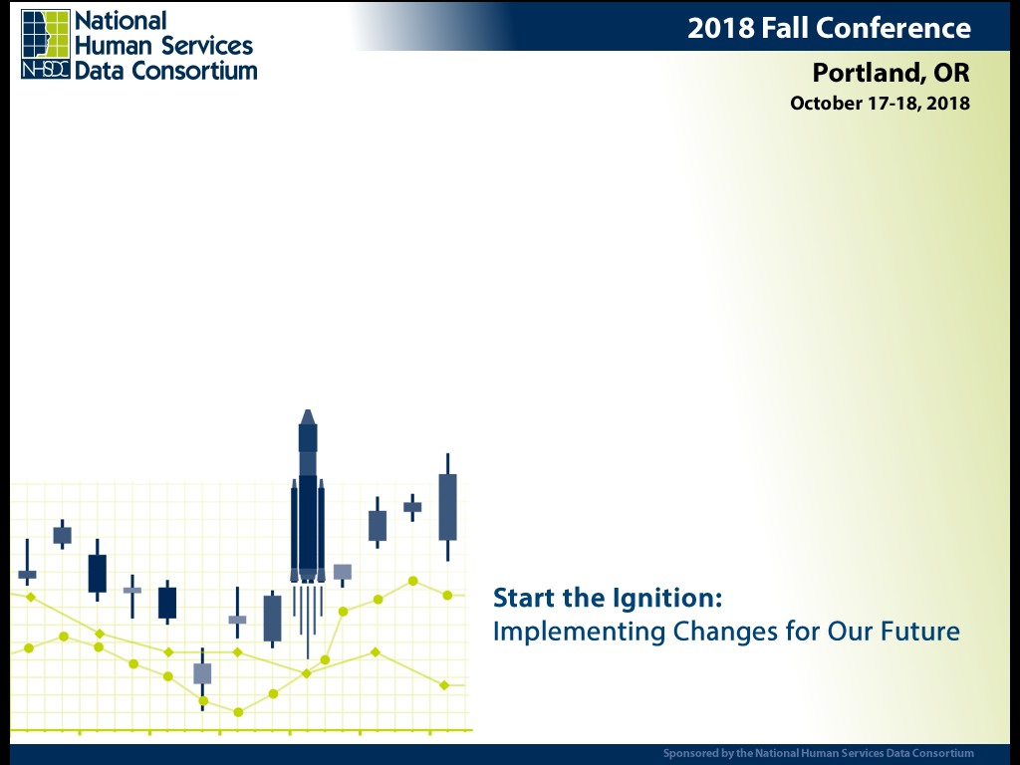
Uses of System Modeling to Build Consensus in Homeless Intervention Strategies

Slide 2

Me
Gerrit Nyland
Catholic Community Services of Western Washington
  Rapid Rehousing, Permanent Supportive Housing, Diversion, Coordinated Entry, Emergency Shelter
Director of Client Information System, SW
Data work - from data entry to system modeling
Software Engineer for 20+ years

Slide 3
Presentation Goals
Justify an interactive system model
Show an interactive homeless system model in action
Review what data you need to do the modeling
Demonstrate how easy it is to make a model

Slide 4
Interactive System Model Benefits
Many learn better by doing
Shiny things attract attention
Intervention costs and outcomes are clear
Sophisticated Presentations boost the credence of the information (sad but true)

Slide 5
The Dangers…
Oversimplification masks many realities
Predicting the future is dicey
Dollar figures can freak people out
Unknown factors and changing realities will always create a significant margin of error

Slide 6
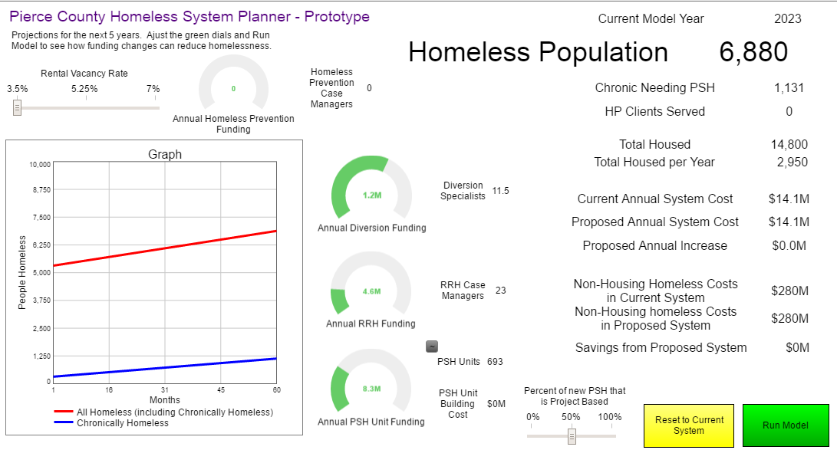
The Demo - https://exchange.iseesystems.com/ directory/gerritnyland

Slide 7
Harvesting your HMIS program data
Roll up all your programs by type –
  Homeless Prevention
  Diversion/Rapid Resolution
  Rapid Rehousing
  Transitional Housing
  Permanent Supportive Housing
  Whatever other weird stuff you do
Commit to Client counts (not household counts)

Slide 8
The Easy HMIS Data
For each type, for the last 12 months:
  Program Spending (Financial Assistance and Staff Costs)
  Case Manager Count
  Clients Served
  Housed Exit Percentage
Interpolate missing data as needed

Slide 9
The Harder Data
Current Homeless Population – hopefully something better than PIT
Permanent Supportive Housing Unit build cost
Annual Inflow to homelessness
Community Cost of Homelessness
  Chronically Homeless (top 5%)
  Everyone else
Percent needing Permanent Supportive Housing

Slide 10
Rate of Self Resolution
  Last Year’s population + inflow – Housed in homeless system – Current Population
  inflow
  5,000 + 10,000 – 2,500 – 6,000
  10,000
=
65%

Slide 11
Really, Really Hard Stuff
Percent that won’t succeed with Rapid Rehousing
Homeless Prevention Effectiveness
  Base your work on research
Housing Rental Vacancy Rate effect is tough to calculate. I do my best.

Slide 12
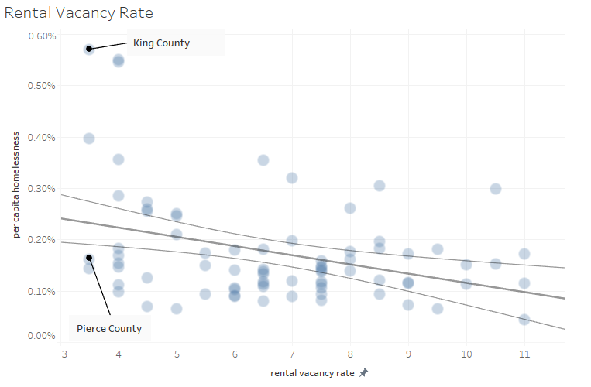

Slide 13
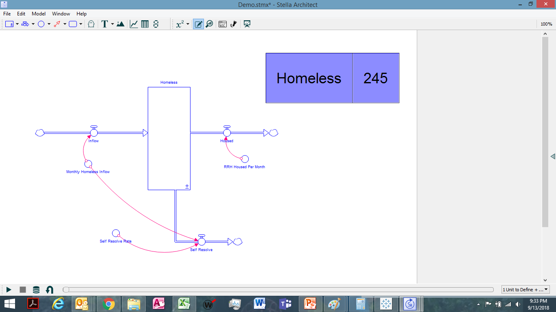
Lets Build a Model
Percent that won’t succeed with Rapid Rehousing
Homeless Prevention Effectiveness
  Base your work on research
Housing Rental Vacancy Rate effect is tough to calculate. I do my best.

Slide 14
The Wrap Up
We need to help funders make good decisions
Interactive Story Telling Rocks
The data is tough to get, but we should really know it all anyway…
Modeling tools are pretty straightforward but not cheap, other tools are out there.

Slide 15
More Me
Gerrit Nyland
gerritn@ccsww.org
253-304-5105
Call me if you come to Tacoma
https://exchange.iseesystems.com/
directory/gerritnyland

