Slide 1
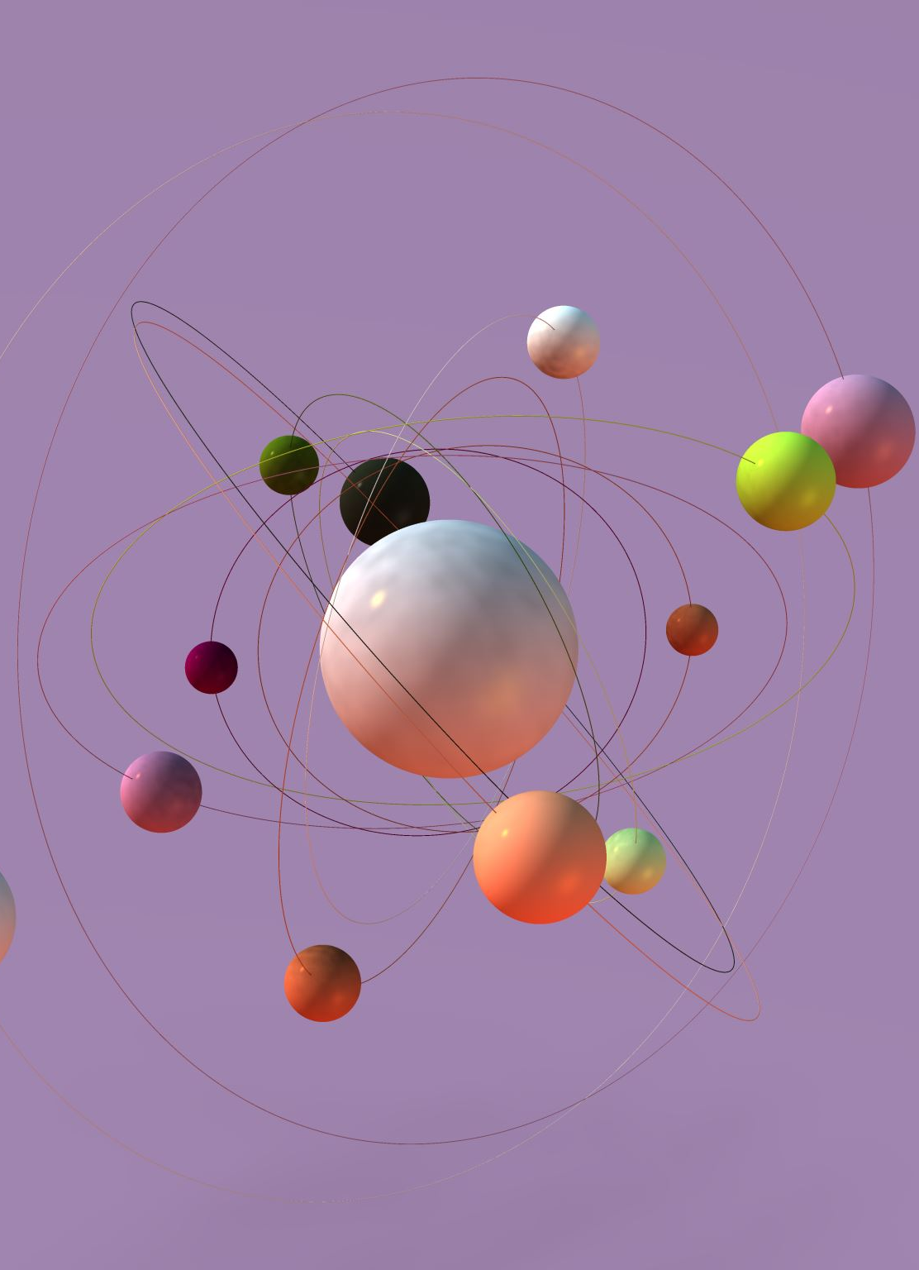
The Solar System: A Brief Overview
Notes:
We're diving into "The Solar System: A Brief Overview." We'll start by introducing the wonders of our cosmic neighborhood, then explore its size, structure, composition, and captivating history. Join us as we unravel the mysteries and marvels of our celestial playground!

Slide 2
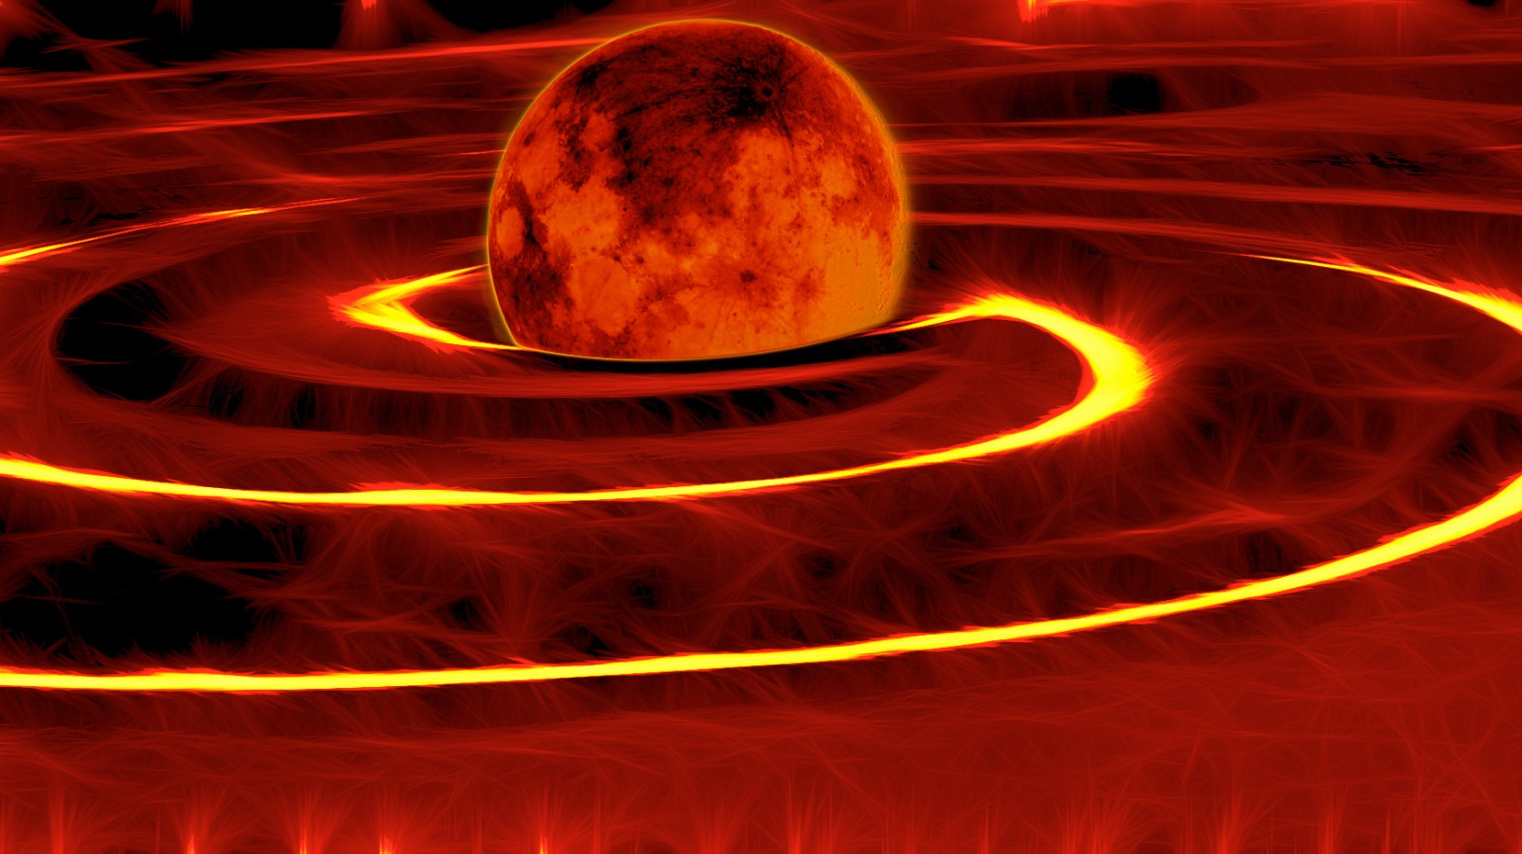
Agenda
Size and Structure
Introduction
Composition and History
Conclusion
Notes:
We'll begin with an introduction to provide context and set the stage for our discussion. Following that, we'll delve into an exploration of our size and structure, examining how our organization is organized and operates. Next, we'll explore our composition and history, highlighting key milestones and the evolution of our organization over time. Finally, we'll conclude our presentation by summarizing key points and highlighting the significance of our collective journey. Let's proceed with an insightful exploration of our organization's story and identity.
Original Content: Agenda *Introduction *Size and Structure
*Composition and History
*Conclusion

Slide 3
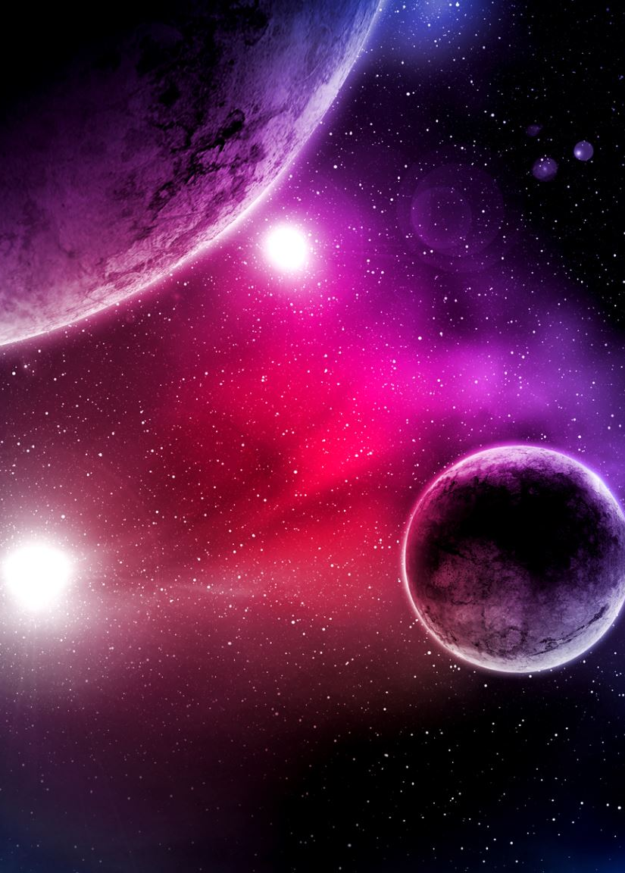
Introduction
The Solar System is the name given to the group of planets, moons, asteroids, comets, and other celestial bodies that orbit the Sun
The Solar System is estimated to be about 4.6 billion years old, and it is constantly changing due to the gravitational interactions among its members
In this essay, we will explore some of the main features and facts about the Solar System, such as its size, structure, composition, and history
Notes:
In this introduction, we embark on an exploration of the Solar System, a vast cosmic ensemble comprising planets, moons, asteroids, comets, and other celestial entities orbiting the Sun. Estimated to have formed around 4.6 billion years ago, the Solar System remains in a perpetual state of flux, shaped by gravitational forces exerted among its constituents. Throughout our discussion, we will navigate through essential facets of the Solar System, including its dimensions, structure, elemental makeup, and evolutionary history.
Original Content: The Solar System is the name given to the group of planets, moons, asteroids, comets, and other celestial bodies that orbit the Sun. The Sun is the star at the center of the Solar System, and it provides most of the light and heat that sustains life on Earth. The Solar System is estimated to be about 4.6 billion years old, and it is constantly changing due to the gravitational interactions among its members. In this essay, we will explore some of the main features and facts about the Solar System, such as its size, structure, composition, and history.

Slide 4
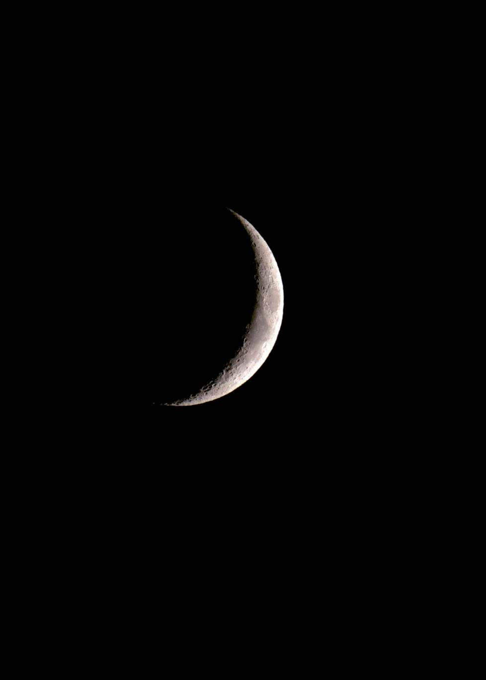
Size and Structure
The Solar System is roughly flat and disk-shaped, and it is divided into two regions: the inner Solar System and the outer Solar System
The inner Solar System consists of the four rocky planets: Mercury, Venus, Earth, and Mars, and the asteroid belt, which is a ring of thousands of small, irregular bodies
The outer Solar System consists of the four gas giant planets: Jupiter, Saturn, Uranus, and Neptune, and the Kuiper belt, which is a similar ring of icy bodies beyond Neptune
Notes:
In understanding the size and structure of our solar system, we find a fascinating dichotomy. Divided into two regions, the inner and outer solar system, it forms a flat, disk-shaped expanse. The inner solar system hosts the four rocky planets - Mercury, Venus, Earth, and Mars - alongside the asteroid belt, a constellation of countless small, irregular bodies. Meanwhile, the outer solar system boasts the majestic gas giants - Jupiter, Saturn, Uranus, and Neptune - as well as the Kuiper belt, a parallel ring of icy bodies stretching beyond Neptune's realm. This dual arrangement offers insight into the diverse composition and dynamic nature of our celestial home.
Original Content: The Solar System is roughly flat and disk-shaped, and it is divided into two regions: the inner Solar System and the outer Solar System
The inner Solar System consists of the four rocky planets: Mercury, Venus, Earth, and Mars, and the asteroid belt, which is a ring of thousands of small, irregular bodies
The outer Solar System consists of the four gas giant planets: Jupiter, Saturn, Uranus, and Neptune, and the Kuiper belt, which is a similar ring of icy bodies beyond Neptune

Slide 5

Composition and History
The Solar System is composed of various types of materials, such as metals, rocks, gases, ices, and dust
The moons of the planets are also diverse, ranging from small, rocky bodies to large, icy worlds with geologic activity and atmospheres
The Solar System also has many smaller objects, such as asteroids, comets, and meteoroids, which are remnants of the planet formation process
Notes:
Exploring the composition and rich history of our solar system unveils a tapestry of diverse materials and celestial phenomena. Comprised of metals, rocks, gases, ices, and dust, our solar system showcases a remarkable array of elements. Furthermore, the moons of our planets exhibit staggering diversity, ranging from petite, rocky bodies to expansive, icy worlds teeming with geological activity and atmospheres. Additionally, our cosmic neighborhood is adorned with numerous smaller objects, including asteroids, comets, and meteoroids, which serve as poignant remnants of the tumultuous planet formation process. Together, these elements weave a narrative of cosmic evolution and intrigue within our solar system's captivating history.
Original Content: Composition and History
The Solar System is composed of various types of materials, such as metals, rocks, gases, ices, and dust
The moons of the planets are also diverse, ranging from small, rocky bodies to large, icy worlds with geologic activity and atmospheres
The Solar System also has many smaller objects, such as asteroids, comets, and meteoroids, which are remnants of the planet formation process

Slide 6
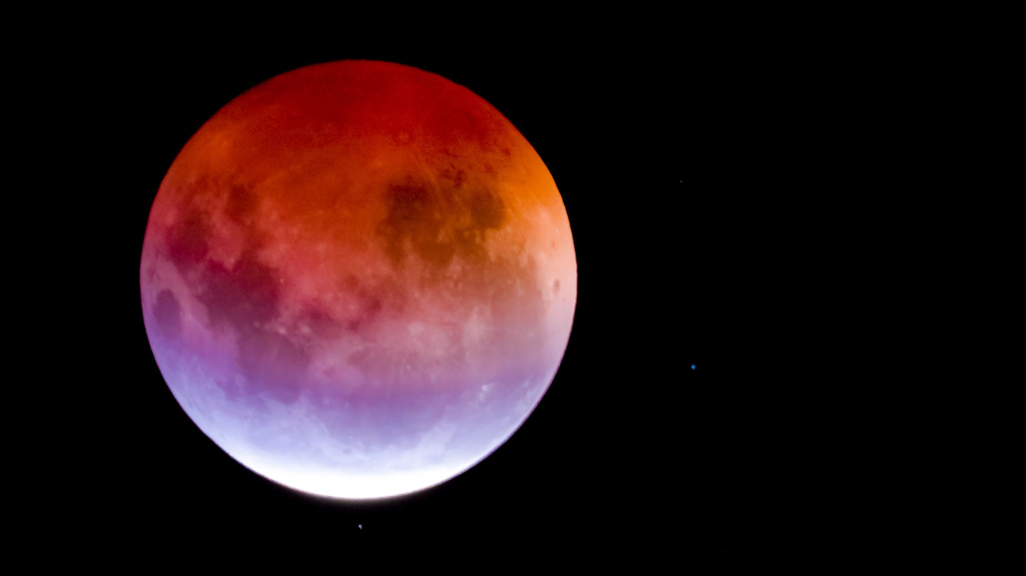
Conclusion
The Solar System is a fascinating and complex system of celestial bodies that orbit the Sun
It is the home of our planet, Earth, and the only place where we know life exists
The Solar System is also a source of wonder and curiosity, as it reveals the diversity and beauty of nature, and the history and origin of our solar neighborhood
Notes:
In conclusion, our exploration of the solar system unveils a captivating tapestry of celestial wonders. Serving as the stage for our planet Earth and the only known harbor of life, the solar system embodies a profound significance in our cosmic journey. As we gaze upon its myriad celestial bodies orbiting the Sun, we're reminded of the boundless diversity and awe-inspiring beauty of nature. Moreover, the solar system acts as a profound window into the origins and history of our cosmic neighborhood, evoking wonder and curiosity in all who contemplate its mysteries. Truly, the solar system stands as a testament to the majesty and complexity of the universe, inviting us to continue our quest for understanding and exploration.
Original Content: Conclusion The Solar System is a fascinating and complex system of celestial bodies that orbit the Sun
It is the home of our planet, Earth, and the only place where we know life exists
The Solar System is also a source of wonder and curiosity, as it reveals the diversity and beauty of nature, and the history and origin of our solar neighborhood

