Slide 1
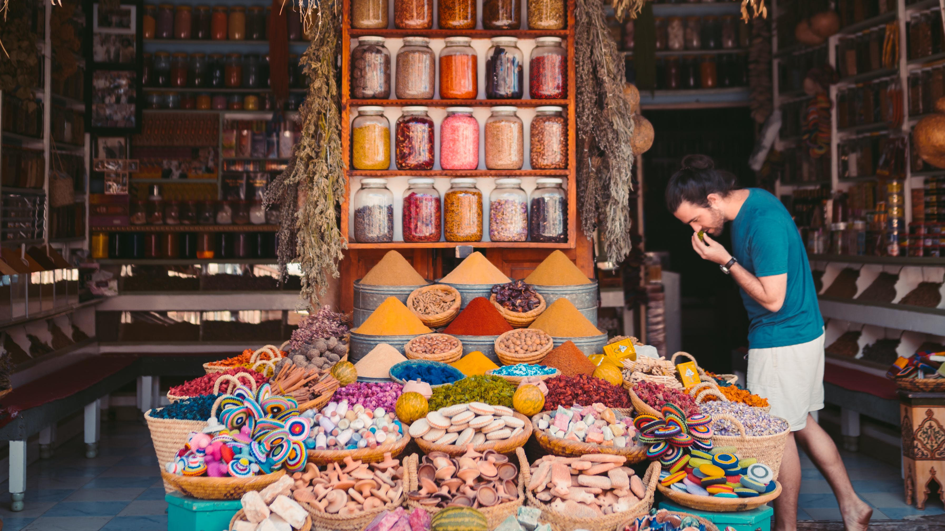
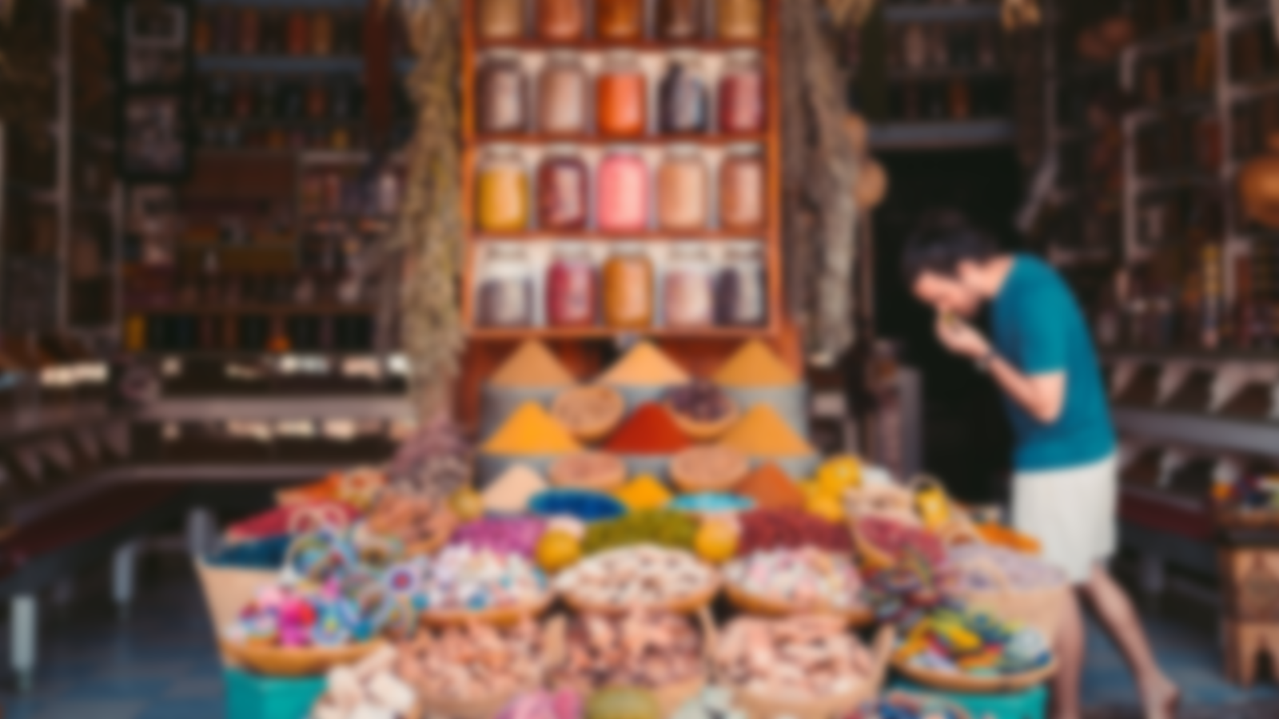

Magical Morocco
Deb’s Super
Awesome
PowerPoint Night

