Slide 1
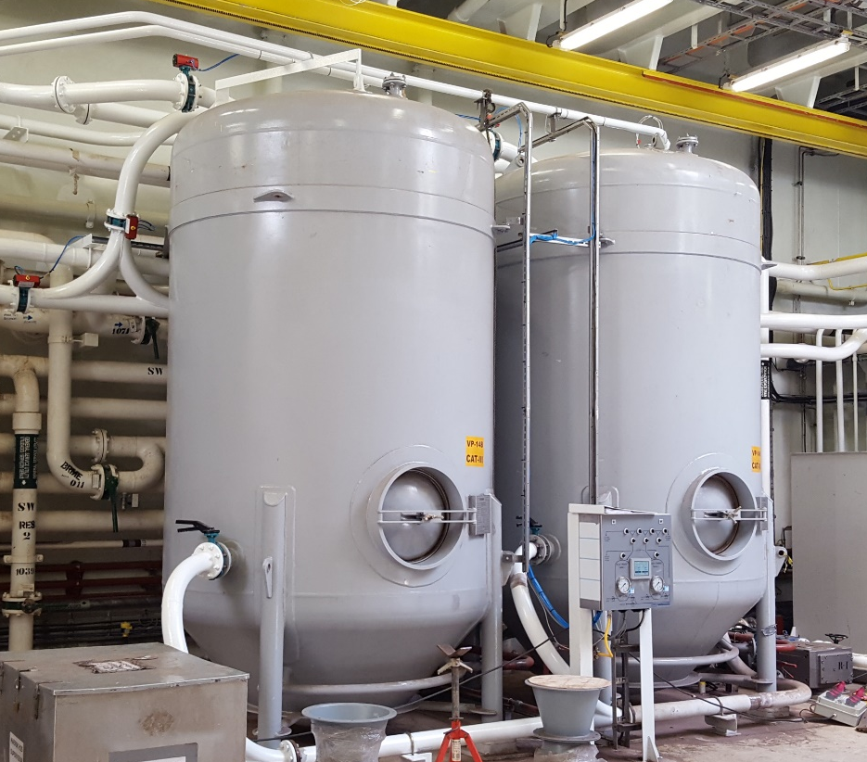
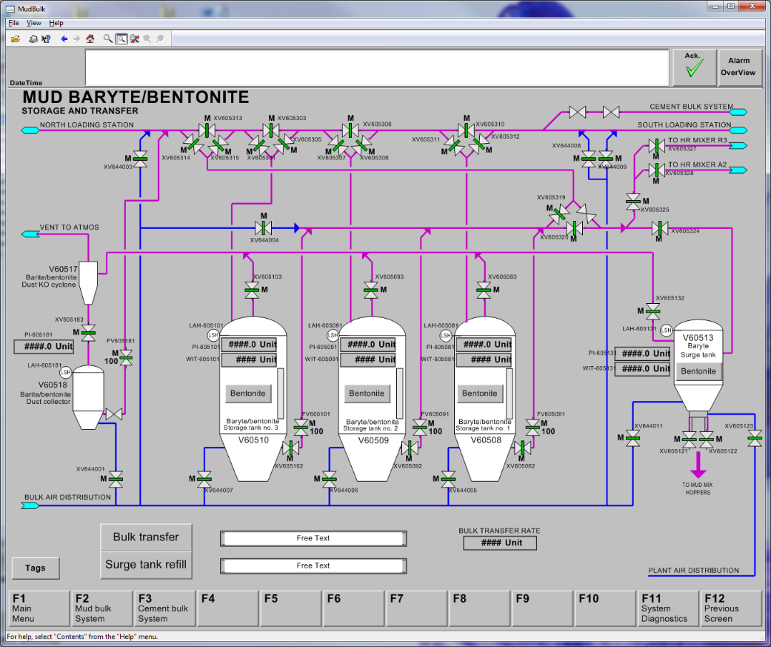
APPLY AS
Moseidsletta122
4068 Stavanger, Norway
Tel: +47 51 63 90 00
E-mail: Utility.Products@APPLY.no
APPLY.no
Bulk Storage & Transfer System
APPLY designs and supplies complete Bulk Tank Storage and Transfer systems for drilling rigs, used to hold dry cement and dry mud bulk materials as barite and bentonite. The advantages of APPLY’s Bulk Systems are custom made design of pressure vessels with flanges fitted to the actual piping routing, delivery of laterals including valves such that the yard is only delivering single piping sections, calculation of piping system pressure losses and flow capacity, use of canvas mats for efficient fluidizing of the bulk material, and turn-key supplier of automatic control systems including total instrumentation and valve packages.
A typical delivery of a drilling bulk system consists of:
Storage tanks for bulk mud and bulk cement, typical a plant of 6-10 tanks each between 20-120m³
Surge tanks each 3-5m³ for mixing cement slurry in cement room, and mud mixing in sack room
Collector tanks with cyclones
Purge, delta and wyy laterals for branching of piping
Package of butterfly valves with remote or local control
Instrumentation package
Control system
Misc options as loading stations, rock catchers, bulk air dryer, sampling devices, Hi-Rate Barite mixer
Above is shown a couple of small 14m³ cement storage tanks custom designed for an intervention vessel.
To the left is shown a screen dump from a Bulk and Mud Control System for a production platform with a drilling facility. Transfer of bulk material may be performed manually by selecting individual valves, or automatically by selecting source and destination tanks.
Utility.Products@APPLY.no Tel: +47 51 63 90 00 APPLY.no

Slide 2
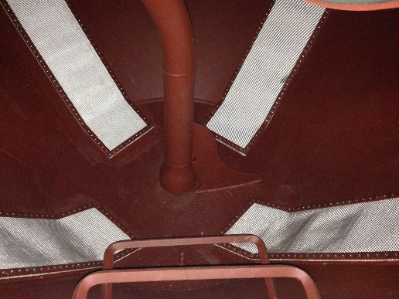
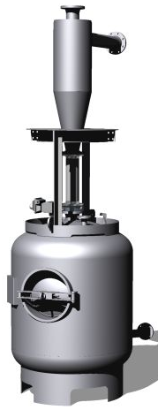
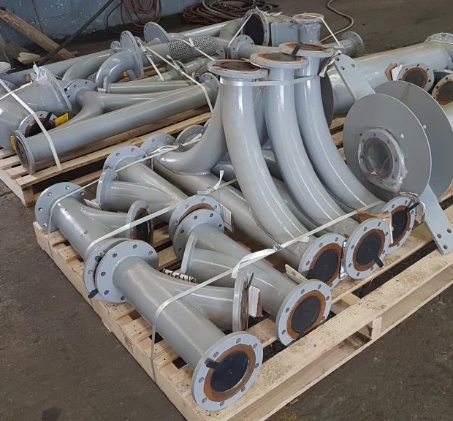
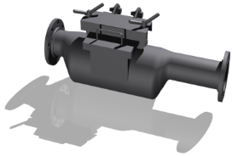
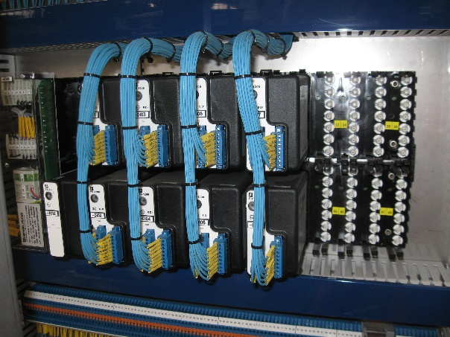
To the left is shown white boxes with canvas mats for fluidizing the bulk powder inside a bulk tank, and the discharge pipe inlet near the bottom of the storage tank. The woven fibre mats provide an even distribution of air, avoid tunneling effects, create less pressure loss compared to traditional nozzle heads, and ensure near total emptying of bulk powder from the tank.
TECHNICAL SPECIFICATION
See individual product information for size and weight information.
Design code EN 13445 test group 3B, others on request (DnV, ABS, ASME). Typical acceleration 1.3m/sec² or according to vessel specifications
Ambient temperature -5 to +50 degrC
Operating pressure typical 4.2- 5.6bar (60- 80psi), design pressure 6.3bar (90psi)
Ports DN or ANSI: Filling 5”, ventilation 5”, aeration 2”, surge tank gravity discharge 10 or 20”, optional discharge 5”, pressure gauge G1”, pressure transmitter G1”, high level switch G1.5”, relief valve 1.5”, manual sounding 2”, manway Ø600mm
Instrumentation package with pressure gauges, pressure transducers, level switches, pressure relief valves, load cells and/or microwave level wires, valves with end limit switches, pneumatic valves.
Atex certified for use in hazardous zone 2, Ex 3 G IIB T3
Electric supply 230V for control system, 3-phase 400- 690V/ 50-60Hz, for cell feeder motor 2.2kW
Bulk air supply requirement 3“ line #150 (PN10) sch 40, typical 9-12Nm³/min, dew point min. -30degrC, 4.2-5.6bar, pressure depending on vertical elevations, sequence of laterals and piping lengths
Request delivery with Siemens PLC based controlled system, and Windows PC based touch screens and Human Machinery Interface (HMI) for total Bulk Storage and Transfer System control
Networked system with communication protocols to the rig’s Drilling Control and Data Acquisition (DCDA) system with shore based monitoring and cloud interfacing.
Above is shown a collection of bulk laterals These laterals are cost efficient “open style” with valves at its ends. Some customers prefer “closed style”, to be agreed.
Above is shown a 2 m³ collector tank, with cyclone above, with inlet for ventilation air from bulk tanks. Secondary filter sections can be delivered upon request.
Above is shown a rock catcher, installed directly after the hose loading stations. The function is to catch lumps of wet bulk powder, if the loading hose has been exposed to water at its coupling end. Sampling stations may be delivered integrated with rock catchers.
Above is shown a remote I/O junction box, with control system interface to instruments and automated valves. These units are typically installed near a cluster of bulk tanks or valve manifolds, in order to reduce cabling cost
Utility.Products@APPLY.no Tel: +47 51 63 90 00 APPLY.no
Rev 2021

