Slide 1


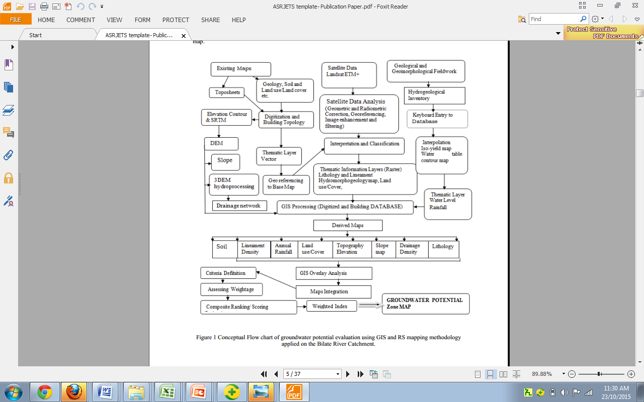
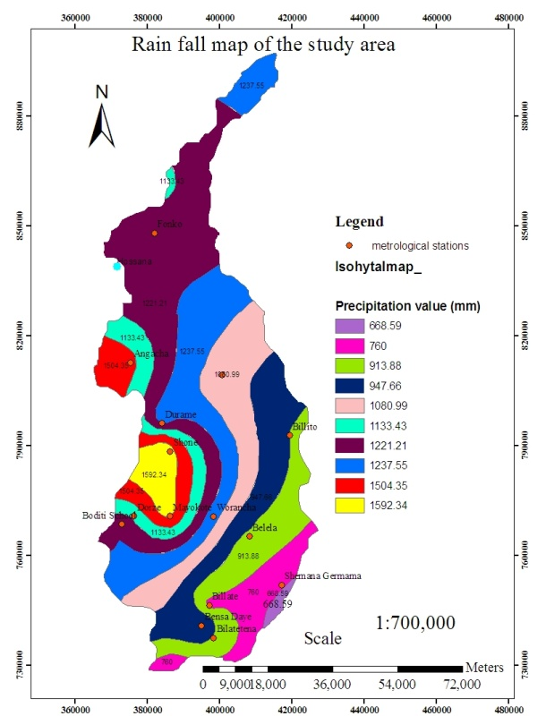
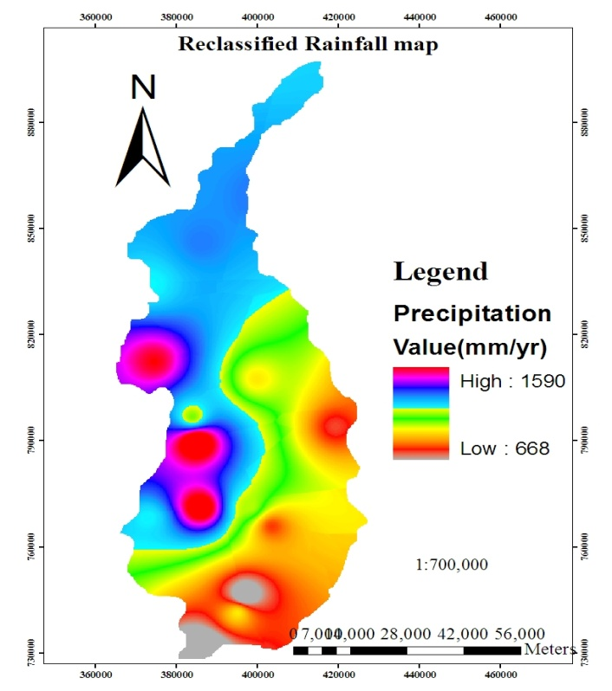
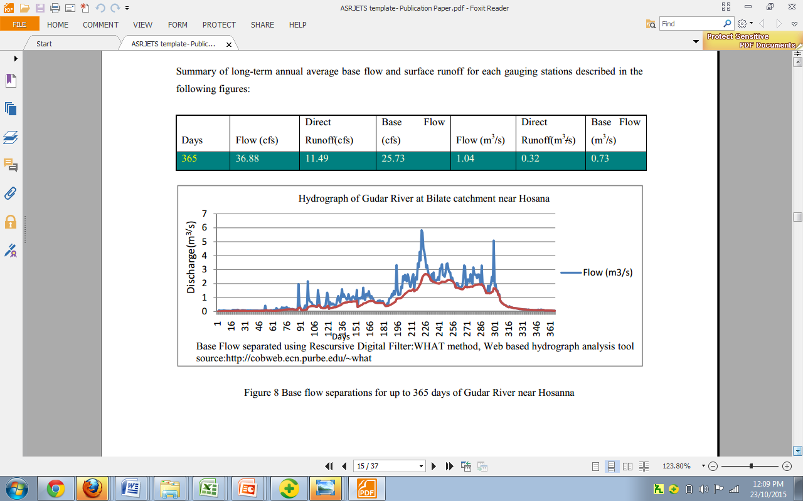
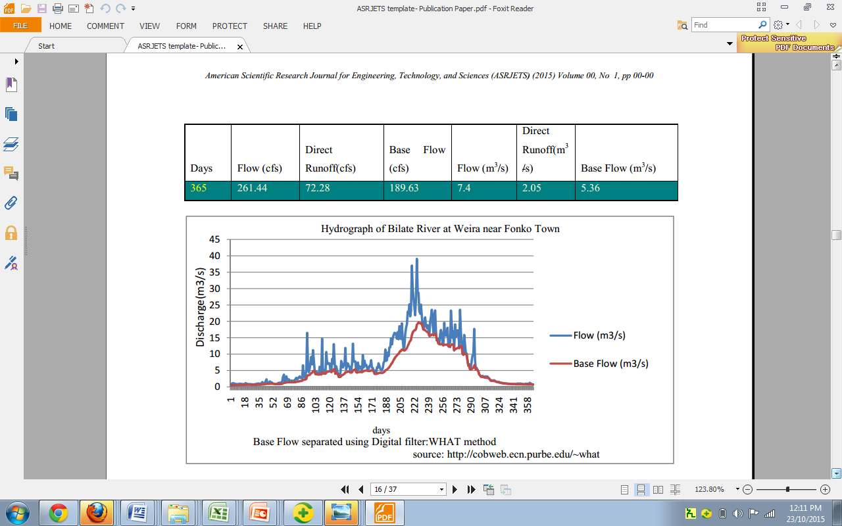
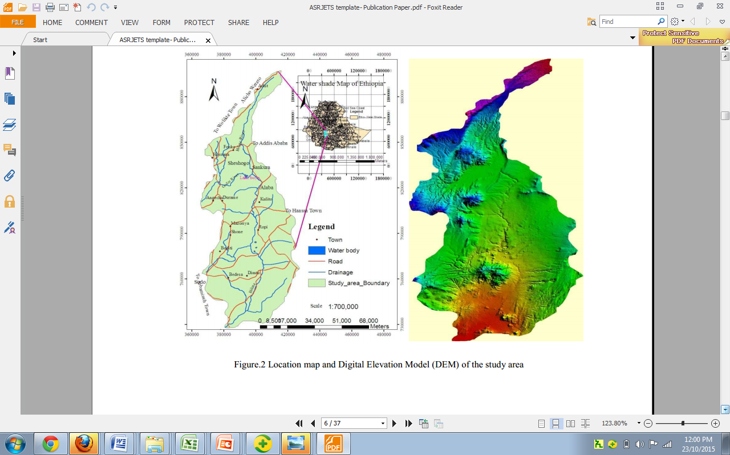
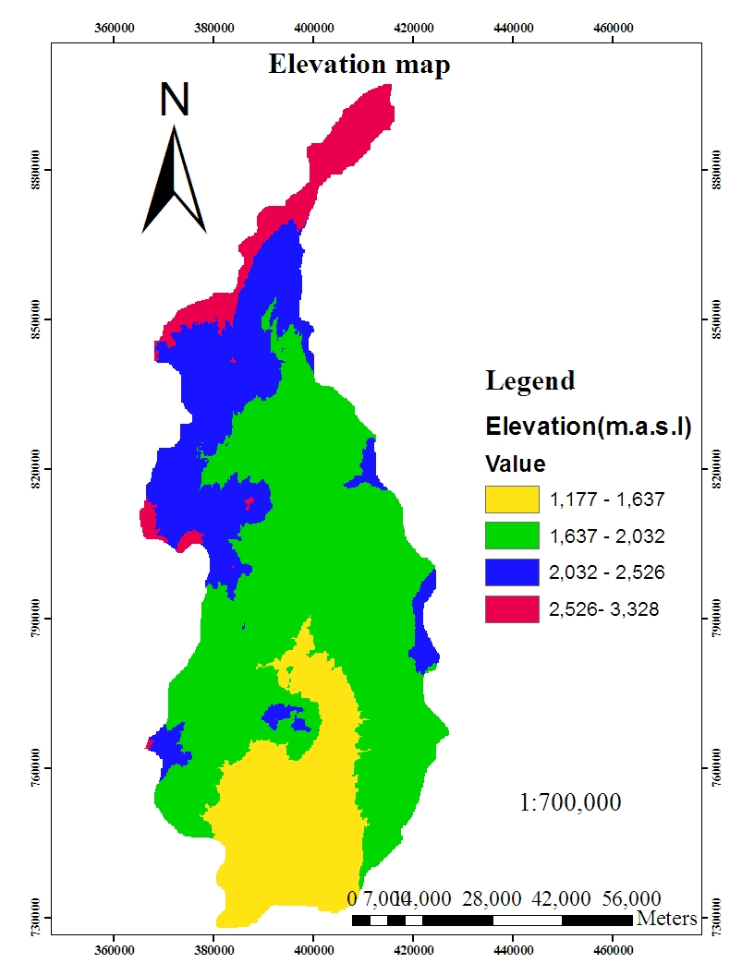
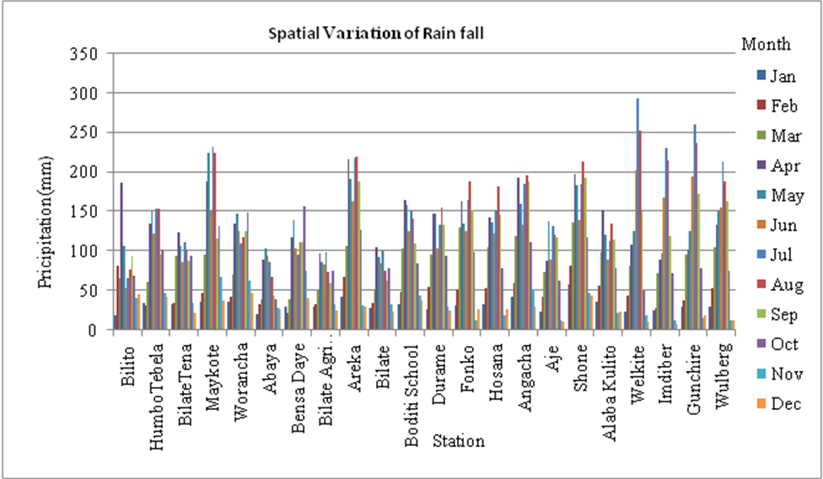
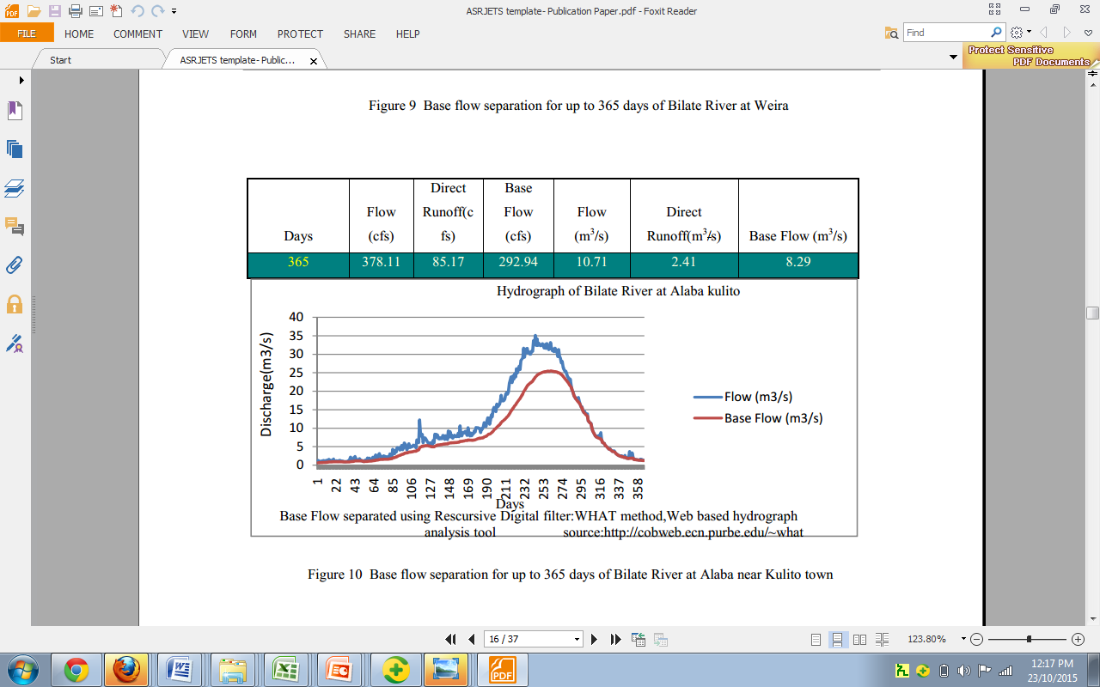
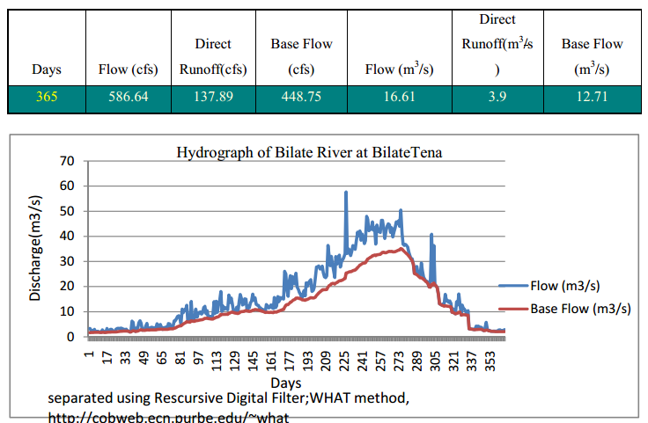
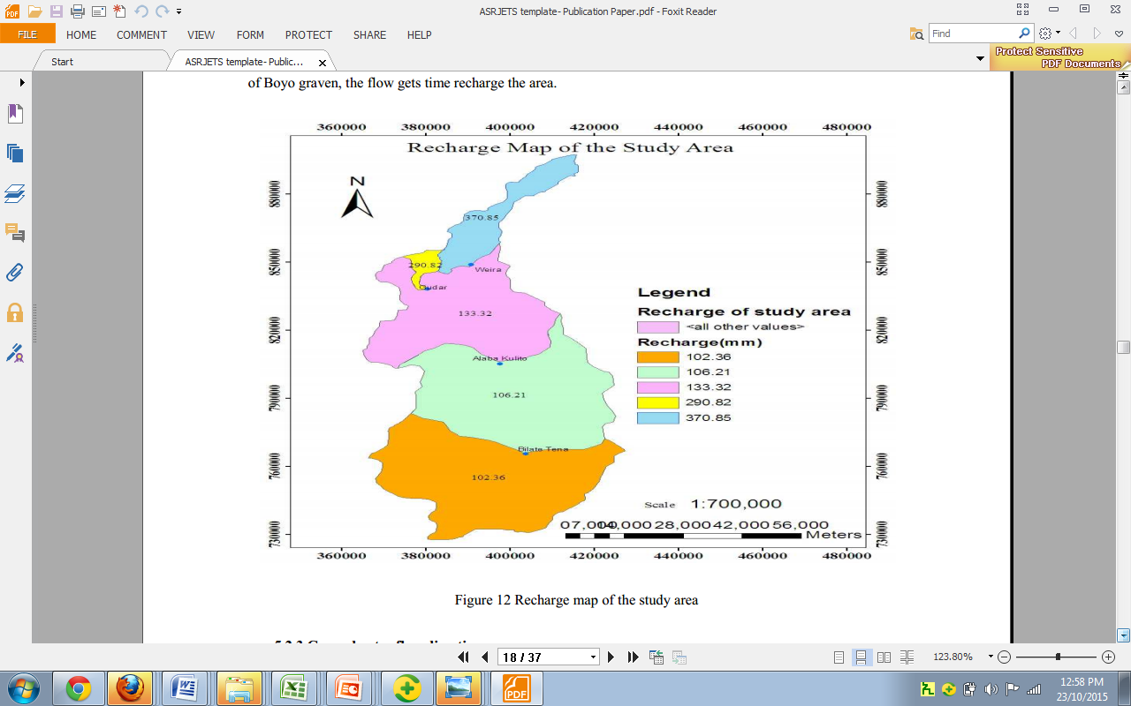
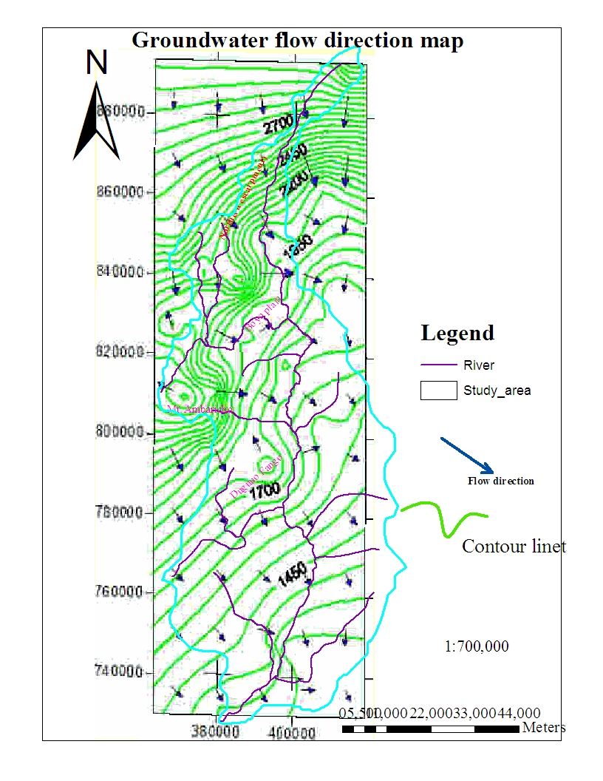
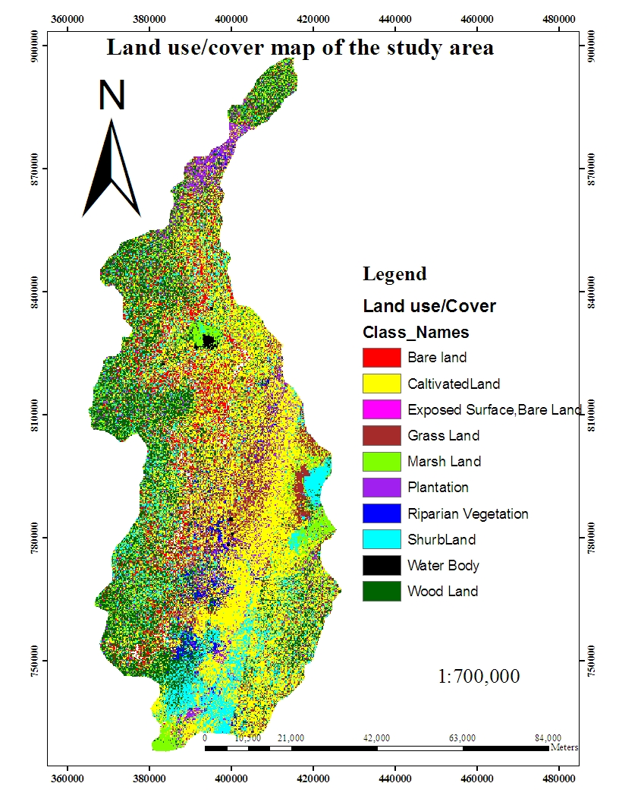
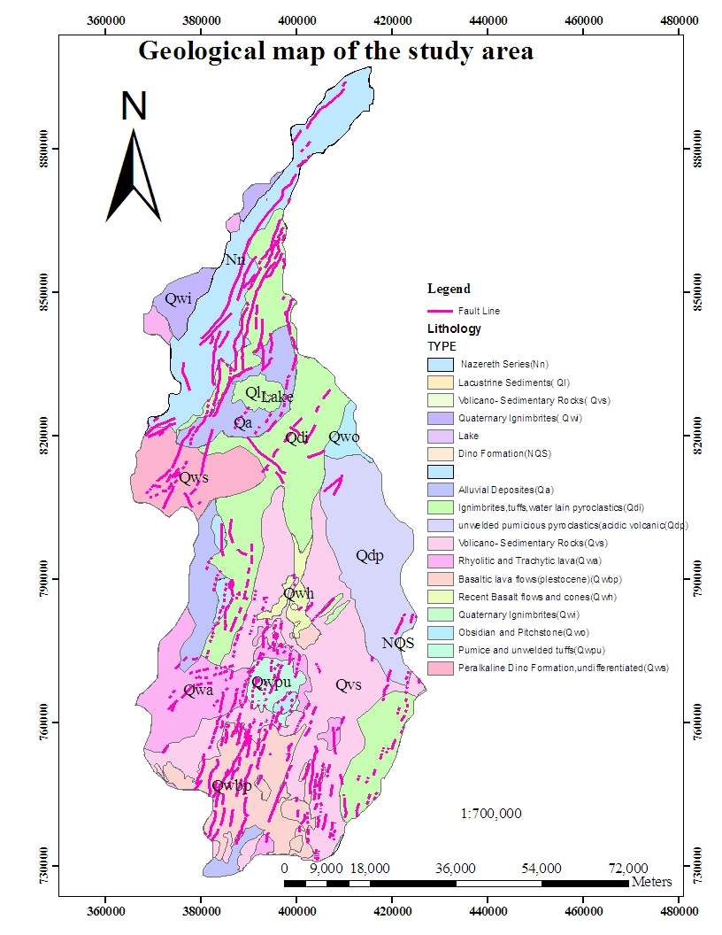
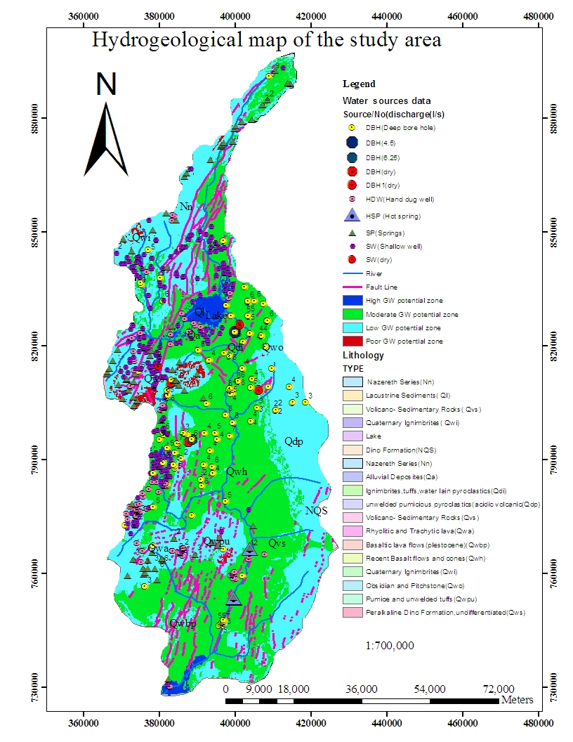
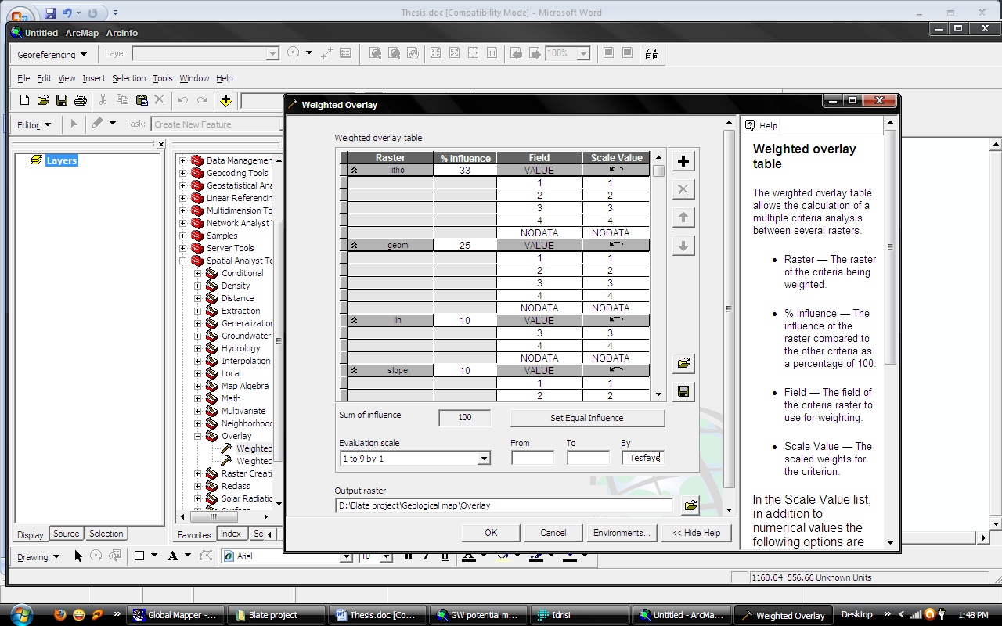
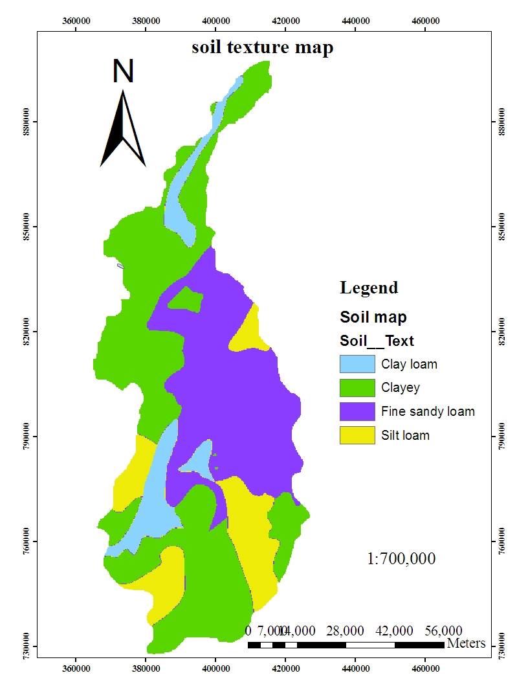
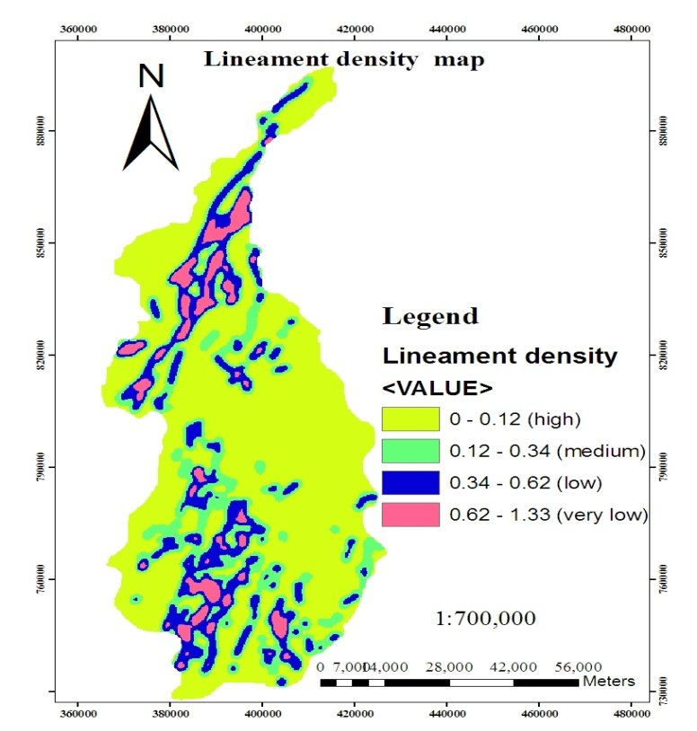
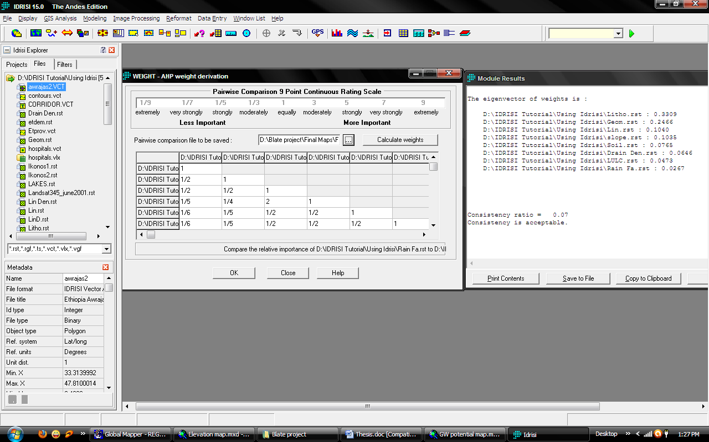
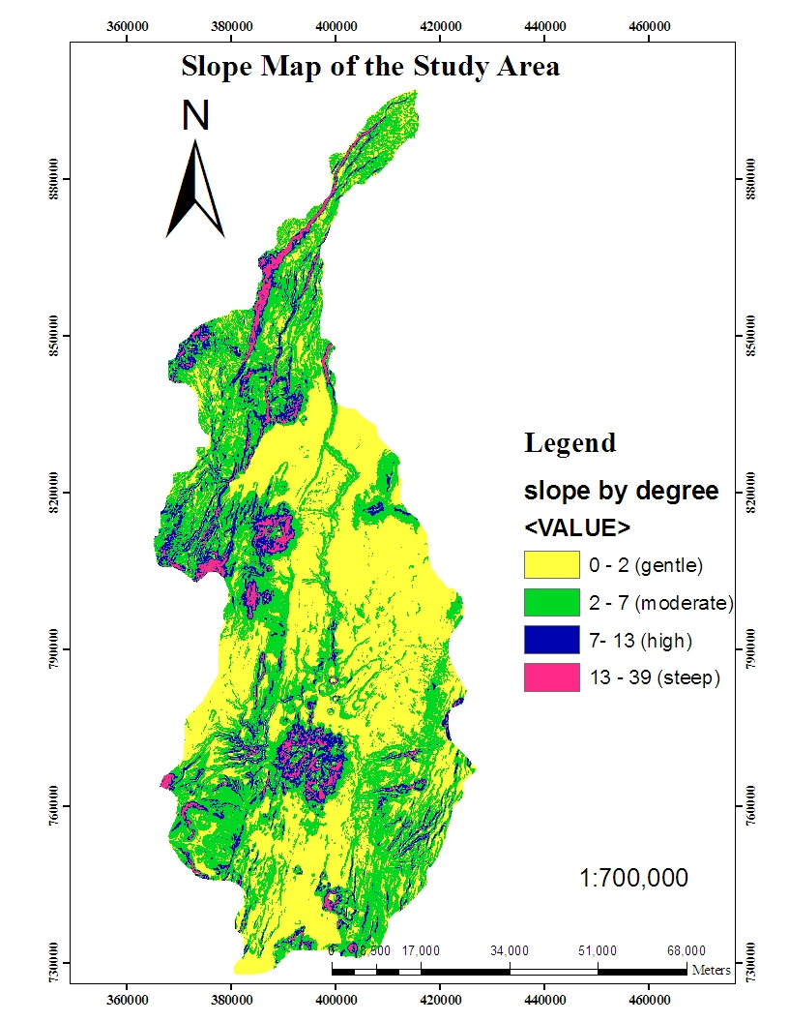
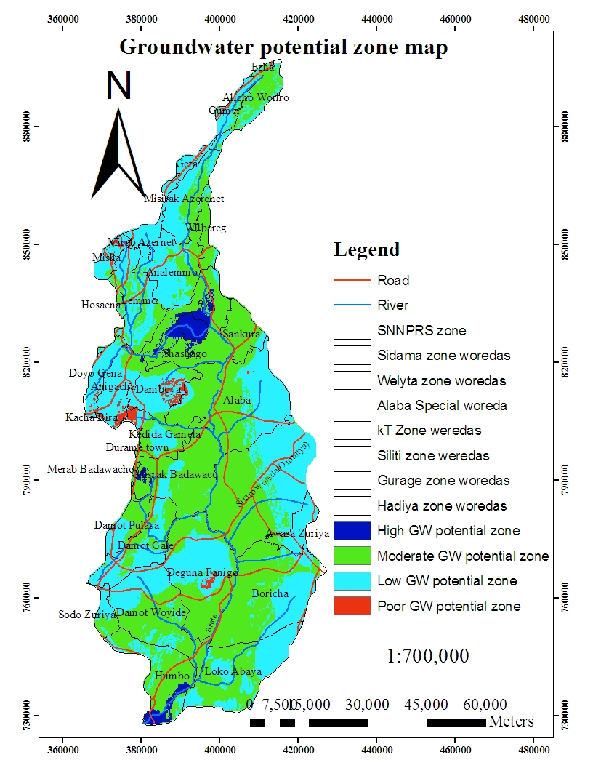
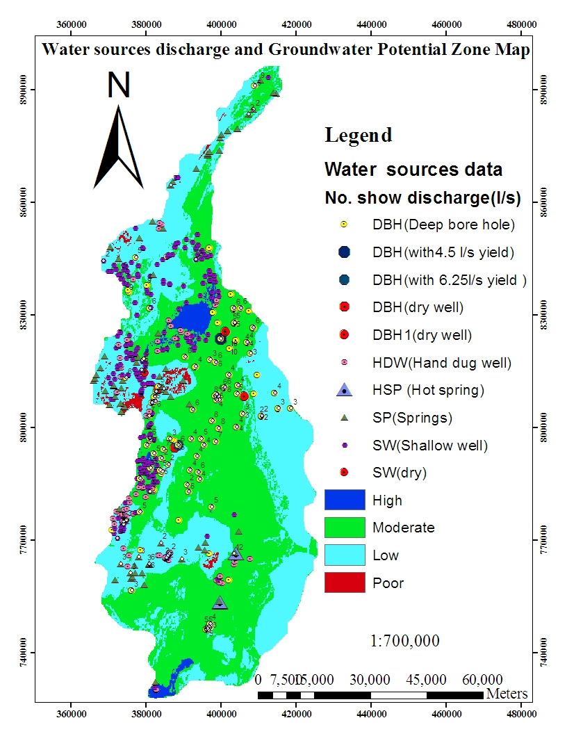
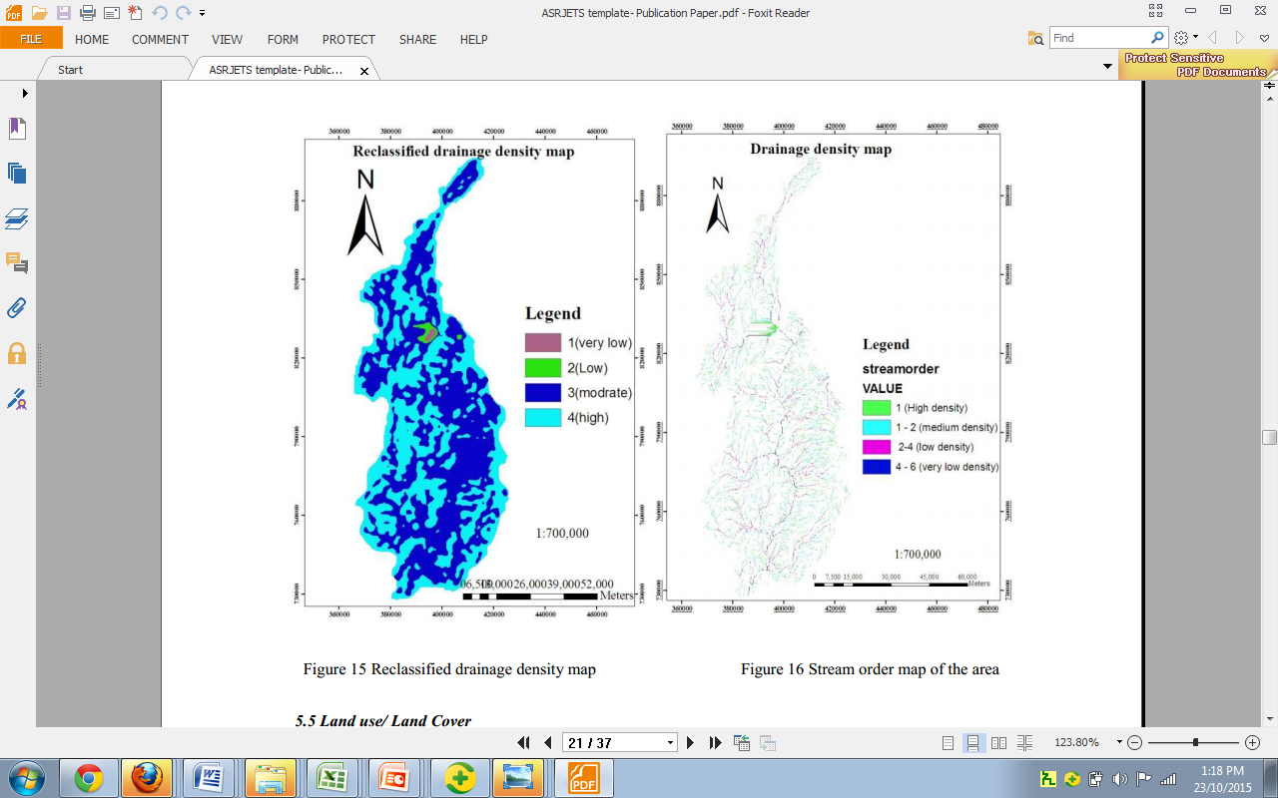
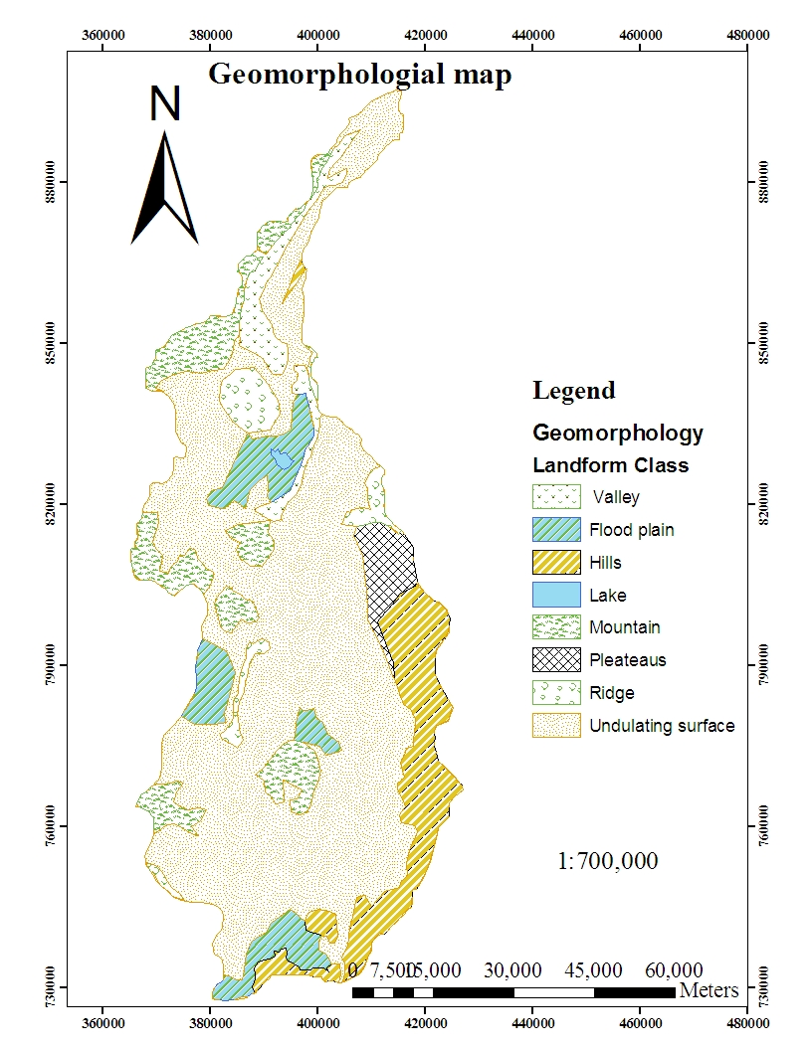
Ground Water Potential Evaluation Based On Integrated GIS and Remote Sensing Techniques, In Bilate River Catchment: South Rift Valley of Ethiopia
Tesfaye Tessema Gintamo
Ethiopian Kale Heywet Church Development Commission Integrated Water and Sanitation Program, Email: tesg2005@yahoo.com
Back Ground
Methods:
In the present study, an attempt had been made to delineate and classify possible groundwater potential zones in the Bilate River catchment using integrated remote sensing and GIS techniques.
The study area is part of the main Ethiopian rift, it is highly affected by the uplift and subsequent rifting phenomena that created localized and regional fractures and faults of volcanic rocks;
Moreover, the complex spatial and temporal distribution of the volcanic rocks, their different intricate stratigraphic and structural relationships, wide compositional variability, different degree of weathering and topographic position complicate the hydrogeological behavior of the volcanic aquifers and the hydrochemical signature requires systematic and scientific approach of investigation to determine the groundwater potential in the area.
The study was carried out in several stages to delineate potential groundwater zones as described in the following steps.
Dataset Identification
The occurrence and movement of ground water controlling factors generated primarily from satellite imageries and existing data
The collected relevant data, in the initial stage of GIS spatial database development various analogue maps were converted into digital format
Building the Research Geodatabase
The generated, collected and digitized data was organized into logical groups of entities
Then, individual entities assigned and converted to characteristic spatial representation format
After making decision on the research geodata base, the data sets prepared
In order to demarcated the groundwater potential zones of study area different thematic maps prepared
Groundwater potential zone map prepared using overlay analysis using IDRIS and ArcGIS software’s.
Data Analysis
In this stage, digital image processing of the satellite data carried out for extraction of pertinent information
The different polygons in the thematic layers labeled separately and then they were converted to raster and registered
Prior to integration of different information, individual class weights and map scores was assessed based on Satty’s Analytic Hierarchy process
.
Research Objectives
Fig. 5 Isohytal rainfall map of the study area
Fig.6 Reclassified Rainfall map of the study area
Summary of long-term annual average base flow/recharge and surface runoff for each gauging stations described in the following figures:
To evaluate and delineate ground water potential zones in the Bilate River catchment using integrated geographic Information system (GIS) and Remote sensing techniques.
To evaluate the ability of currently used GIS and remote sensing techniques to distinguish or delineate target features controlling groundwater occurrence.
To produce hydrogeological map of the area based on the available data interpretation and analysis that will be a good basis for detailed groundwater exploitation work
To identify the degree of role of groundwater occurrence and distribution controlling parameters in the study area and their relationship to each other.
.
Fig. 2 Conceptual Flow chart of groundwater potential evaluation using GIS and remote sensing mapping methodology applied on the Bilate River Catchment.
Thematic maps for groundwater controlling parameters prepared as follows:
Table 1 Satty’s Analytic Hierarchy process a nine point important scale
Rating | 1/9 | 1/7 | 1/5 | 1/3 | 1 | 3 | 5 | 7 | 9
Qualitative description | Extremely | Very Strong | Strongly | Moderately | Equally | Moderately | Strongly | Very Strongly | Extremely
 | Less Important |  |  |  |  | More Important
Table 2 Summary of Computed recharge in the study area
Data Interpretation
.
The weight values of final map further logically was classified and integrated to arrive at groundwater potential zone map of the area
.
ID | Gauging Station N | Area enclosed(m²) | Drainage area(m²) | Runoff (m3/s) | Recharge (m3/s) | Recharge (m/y) | Recharge (mm/yr)
0 | Bilatetena | 1813000000 | 3773960000 | 3.9 | 12.71 | 0.11 | 106.21
1 | Abaya | 1863000000 | 5636960000 |  |  |  | 102.36
2 | Gudar | 79160000 | 79160000 | 0.32 | 0.73 | 0.29 | 290.82
3 | Weira | 455800000 | 455800000 | 2.05 | 5.36 | 0.37 | 370.85
4 | Alaba kulito | 1426000000 | 1960960000 | 2.41 | 8.29 | 0.13 | 133.32
Fig. 1: Location Map and Digital Elevation Model(DEM) of The Study Area
Fig. 3 Elevation map of the study area
Fig.4 Mean monthly precipitations in the study area and nearby meteorological stations
Fig.11Recharge map of the study area
Criteria weights and Map Scores
After categorization, all the reclassified thematic layers were integrated with one another through GIS using the weighting overlay analysis as follows.
To determine the relative importance or weights of each thematic map with another paired -comparison matrix was prepared by pair wise comparison on Satty’s importance scale.
These matrices have the property of consistency known as consistency ratios (CR). Satty indicates that the matrices with CR ratings greater than 0.1 should be re-evaluated. This way it helps to analyses the matrix to determine the inconsistency in defining the interrelationships. In this case the consistency value was 0.07 which is accepted .
After categorization, all the reclassified thematic layers were integrated with one another through GIS using the weighting overlay analysis as follows.
Fig.12 Groundwater flow direction map of the study area
Fig.15 Land use/ Land cover map of the area
Fig. 18 Geological map of the area
The importance matrices and their weights are mentioned as follows:
Figure 23 Hydrogeological map of the study area
Fig. 21 weighted Overlay analysis table to produce Groundwater potential zone map
Conclusions
Output/Groundwater potential zoning map
It is concluded that the integrated GIS and remote sensing techniques are very efficient and useful, time and cost effective tool for the identification/delineation of groundwater potential zones
Groundwater potential zone map. 'high, 'moderate’,' low’ and 'poor'. Were identified for Bilate River Basin.
. Hydro geological map of the study area compiled using geological map, lineament map and water point source data
Results Validation
Fig.20 Weights of parameters determined using analytical hierarchy principle nine point scales
References:
Fig.13 Slope map of the study area
Fig.16 Reclassified FAO, 1997 Soil map the area
Fig. 19 Lineament density map of the area
Table 4 Paired Comparison matrix
Fares M. Howari, Mohsen M., Sherif¹, Vijay P.Singn² and Mohamed S. Al Asam3, 20017, Geology Dept., College of Science, UAE University, Al Ain, UAE
Amaresh Kr. Singh, S. Ravi Prakash, Map India, 2003, an integrated approach of Remote Sensing, geophysics and GIS to evaluation of Groundwater Potentiality of Ojhala Subwatershed, Mirzapur district, U.P., India
Arun K. Saraf, P. Kundu, B. Sarma,1999, Integrated Remote sensing and GIS in Groundwater Recharge Investigation And Selection of Artificial Recharge sites in Hard Rock Terrain, Indian Institute of Technology, ROORKEE-247667,India
Timothy B., Jerome A., Matthew M. and Robert B., 1994, An integrated approach to groundwater exploration in developing countries using GIS and remote sensing, Desert Research Institute,7010 ,Dandini Blvd.Reno, NV 89512*U.S. Army Corp of Engineers - Topographic Engineering Center Alexandria, VA 22310.
Ayenew, Demlie and Stefan, 2008, Hydrogeological framework and occurrence of groundwater in the Ethiopian aquifers, Journal of African Earth Sciences, Addis Ababa University, Department of Earth Sciences,
Results and Discussions
 | Litho | Geom | Lin | Slope | Soil | Drain Den | LULC | Rain Fa | Weight | Weight (%)
Litho | 1 | 2 | 2 | 5 | 6 | 6 | 6 | 7 | 0.3329 | 33
Geom | 1/2 | 1 | 2 | 4 | 5 | 5 | 5 | 6 | 0.2458 | 25
Lin | 1/2 | 1/2 | 1 | 1/2 | 2 | 2 | 2 | 3 | 0.1037 | 10
Slope | 1/5 | 1/4 | 2 | 1 | 2 | 2 | 2 | 3 | 0.1031 | 10
Soil | 1/6 | 1/5 | 1/2 | 1/2 | 1 | 2 | 3 | 4 | 0.0810 | 8
Derain d | 1/6 | 1/5 | 1/2 | 1/2 | ½ | 1 | 3 | 4 | 0.0638 | 6
LULC | 1/6 | 1/5 | 1/2 | 1/2 | 1/3 | 1/3 | 1 | 4 | 0.0460 | 5
Rain Fa | 1/7 | 1/6 | 1/3 | 1/3 | ¼ | 1/4 | 1/4 | 1 | 0.0265 | 3
Data Integration Analysis in GIS Environment
Thematic maps were converted to raster data sets having the same pixel size
Different weightage were assigned as per their groundwater potential controlling capacity within the study area
Reclassification of each map was done based on the weight values produced.
Accordingly, the value 1 was given for highly controlling units, 2 for moderately controlling units, 3 for low controlling units and 4 for poor controlling reclassified units.
Finally the maps integrated using GIS software with the purpose intended to delineate the groundwater potential areas for the study region.
All the weighted thematic maps were integrated and defined criteria weight using the IDRIS software and overlay analysis done using ArcGIS software and potential ground water prospect zones were identified.
Fig.22 Groundwater potential map
Table 5 Area coverage of each Groundwater
potential zone
No | Groundwater Potential Zone | Area Coverage(km²)
1 | High | 158.04
2 | Moderate | 3175.35
3 | Low | 2218.82
4 | Poor | 54.31
Figu.14 Stream order and Reclassified drainage density map of the area
Fig. 17Landscape of the River Basin with prominent topographical features
Litho = Lithology Slope = Slope Geom. = Geomorphology/Land form Soil = Soil Lin = Lineament density Drain d = Drainage density LULC = Land use/ Land cover Rain Fa = Rainfall
Figure 23 Distribution of boreholes and springs with discharge in groundwater potential zone
Acknowledgements
I am grateful to my advisor prof. Tenalem Ayenew, Ethipian Water Resources Ministry, National Meteorological Service, Geological survey, Mapping Agency and SNNPR Water resources development Bureau

