Slide 1
The Greenhouse Gas Quiz
Notes:
This activity is from a complete set of Carbon Literacy training materials & accompanying trainer guide created by Carbon Literacy Consultants Rachel Dunk & Jane Mörk, Manchester Metropolitan University.
The Carbon Literacy training materials are licensed for re-use under a Creative Commons Attribution – Non Commercial – No Derivatives 4.0 International License (CC BY-NC-ND 4.0) – see https://creativecommons.org/licenses/by-nc-nd/4.0/
This license does not apply to third party material incorporated in the Carbon Literacy Training materials. All photographic images used in this slide set are third party content. Attribution and marking of third party content offered under different CC licenses is provided in the notes pages of the appropriate slides.
This slide set is for the Greenhouse Gas Quiz – which is suitable for large group (conference style) training or remote (webinar) delivery. A matching game (Greenhouse Gas Game) version for standard format face-to-face delivery is also available. We have made these materials freely available to support the roll out of carbon literacy training to as many people as possible. All we ask is that you acknowledge Manchester Metropolitan University as the creator of this work – and we would really appreciate it if you would take the time to email us and let us know how you are using the materials (and give any feedback you may have) at carbonliteracy@mmu.ac.uk
We would strongly prefer it if you used our slides as provided – and request that at a minimum our logo and the creative commons license information is included on all slides related to this activity. If you have any questions, please email us.

Slide 2


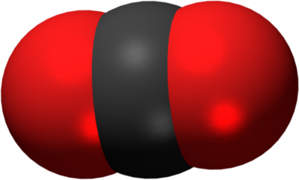
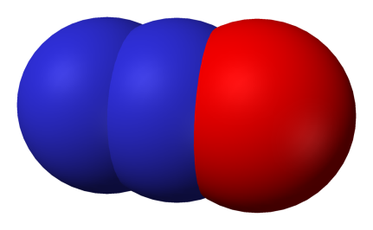
The greenhouse gases
carbon dioxide
CO₂
methane
CH₄
nitrous oxide
N₂O
F gases
(various)
1
28
265
10s-10,000s
mass x GWP → common currency of carbon dioxide equivalents (CO₂e)
Notes:
Introduce the GHGs and Global Warming Potentials (GWPs).
Now we’re going to focus on the greenhouse gases that our (human) activities are adding to the atmosphere.
NOTE: Global Warming Potentials presented here are the 100-year values from the Intergovernmental Panel on Climate Chang Assessment Report 5 (IPCC AR5) - see Trainer Guide for further information.

Slide 3
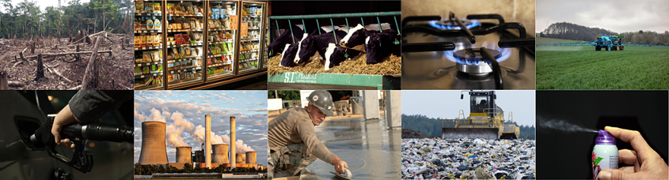
The greenhouse gas quiz
Which activity releases which greenhouse gas?
Notes:
Introduce and explain the activity
IMAGE ATTRIBUTION & MARKING
Burning of Natural Gas: Image by PublicDomainPictures from Pixabay (pixabay.com/photos/appliance-burn-burner-cook-cooker-2257/)
Burning of Oil: Image by Rudy and Peter Skitterians from Pixabay (pixabay.com/photos/petrol-gasoline-diesel-gas-996617/)
Burning of Coal: Image by Benita Welter from Pixabay (pixabay.com/photos/power-plant-industry-chimney-2411932/ )
Cement Production: Image by 272447 from Pixabay (pixabay.com/photos/mason-concrete-float-smooth-cement-694271/)
Land Use Change: Shift cultivation in Columbia from Wikimedia Commons (https://commons.wikimedia.org/wiki/File:Amazon_slash_and_burn_agriculture_Colombia_South_America.jpg). Image by Matt Zimmerman, licensed for reuse under the Creative Commons Attribution 2.0 Generic license (CC BY 2.0) (creativecommons.org/licenses/by/2.0/). No changes made to image.
Ruminant Livestock (p12): Image by 272447 from Pixabay (pixabay.com/photos/cows-cattle-dairy-holstein-farm-526771/)
Landfilling of Waste: Image by Pasi Mäenpää from Pixabay (pixabay.com/photos/landfill-waste-management-waste-879437/)
Fertilisers: Image by Franck Barske from Pixabay (pixabay.com/photos/tractor-fertilizer-pesticide-spray-4217686/)
Refrigerant Gases: Image by Kevin Phillips from Pixabay (pixabay.com/photos/supermarket-fridge-produce-food-949912/).
Aerosol Propellants: Image by 955169 from Pixabay (pixabay.com/photos/fragrance-spray-box-graffiti-night-1502844/).

Slide 4
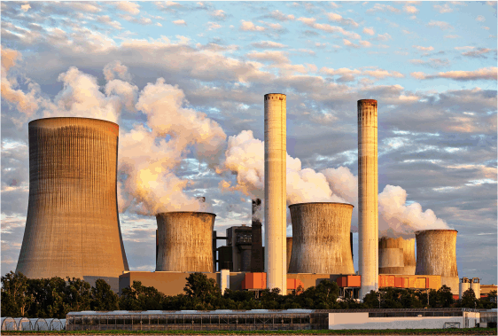
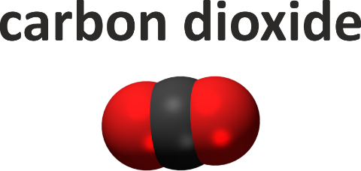
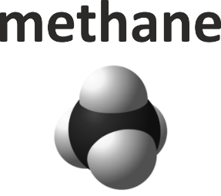
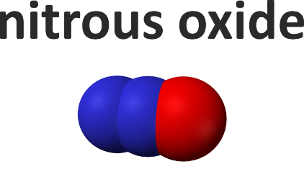
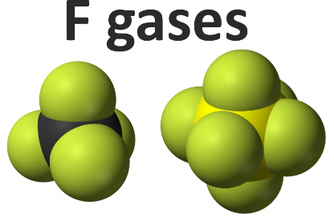
Which GHG?
A
B
C
Burning of Coal
D
Notes:
Burning of Coal (1/2 – QUESTION)
IMAGE ATTRIBUTION
Burning of Coal: Image by Benita Welter from Pixabay (pixabay.com/photos/power-plant-industry-chimney-2411932/ )

Slide 5
Which GHG?
A
B
C
Burning of Coal
D
Notes:
Burning of Coal (2/2 – ANSWER)
IMAGE ATTRIBUTION
Burning of Coal: Image by Benita Welter from Pixabay (pixabay.com/photos/power-plant-industry-chimney-2411932/ )

Slide 6
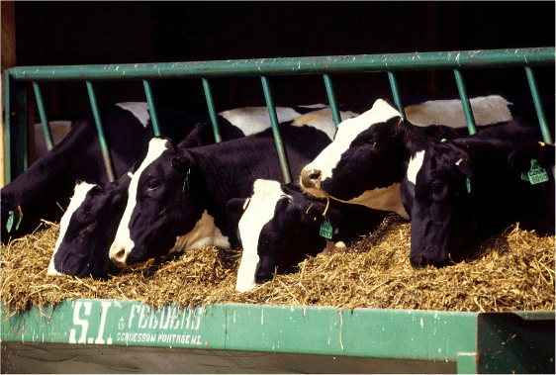
Which GHG?
A
B
C
Ruminant Livestock
D
Notes:
Ruminant Livestock (1/2 – QUESTION)
IMAGE ATTRIBUTION
Ruminant Livestock: Image by 272447 from Pixabay (pixabay.com/photos/cows-cattle-dairy-holstein-farm-526771/)

Slide 7
Which GHG?
A
B
C
Ruminant Livestock
D
Notes:
Ruminant Livestock (2/2 – ANSWER)
IMAGE ATTRIBUTION
Ruminant Livestock: Image by 272447 from Pixabay (pixabay.com/photos/cows-cattle-dairy-holstein-farm-526771/)

Slide 8
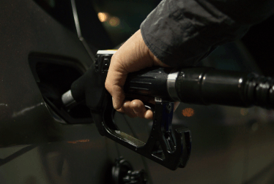
Which GHG?
A
B
C
Burning of Oil
D
Notes:
Burning of Oil (1/2 – QUESTION)
IMAGE ATTRIBUTION
Burning of Oil: Image by Rudy and Peter Skitterians from Pixabay (pixabay.com/photos/petrol-gasoline-diesel-gas-996617/)

Slide 9
Which GHG?
A
B
C
Burning Oil
D
Notes:
Burning of Oil (2/2 – ANSWER)
IMAGE ATTRIBUTION
Burning of Oil: Image by Rudy and Peter Skitterians from Pixabay (pixabay.com/photos/petrol-gasoline-diesel-gas-996617/)

Slide 10
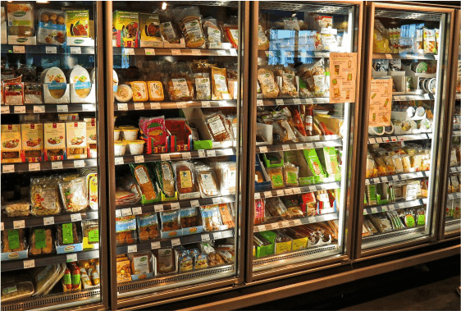
Which GHG?
A
B
C
Refrigerant Gases
D
Notes:
Refrigerant Gases (1/2 – QUESTION)
IMAGE ATTRIBUTION
Refrigerant Gases: Image by Kevin Phillips from Pixabay (pixabay.com/photos/supermarket-fridge-produce-food-949912/).

Slide 11
Which GHG?
A
B
C
Refrigerant Gases
D
Notes:
Refrigerant Gases (2/2 – ANSWER)
IMAGE ATTRIBUTION
Refrigerant Gases: Image by Kevin Phillips from Pixabay (pixabay.com/photos/supermarket-fridge-produce-food-949912/).

Slide 12

Which GHG?
A
B
C
Cement Production
D
Notes:
Cement Production (1/2 – QUESTION)
IMAGE ATTRIBUTION
Cement Production: Image by 272447 from Pixabay (pixabay.com/photos/mason-concrete-float-smooth-cement-694271/)

Slide 13
Which GHG?
A
B
C
Cement Production
D
Notes:
Cement Production (2/2 – ANSWER)
IMAGE ATTRIBUTION
Cement Production: Image by 272447 from Pixabay (pixabay.com/photos/mason-concrete-float-smooth-cement-694271/)

Slide 14
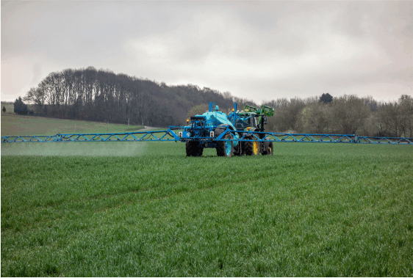
Which GHG?
A
B
C
Nitrogen Fertilisers
D
Notes:
Nitrogen Fertilisers (1/2 – QUESTION)
IMAGE ATTRIBUTION
Fertilisers: Image by Franck Barske from Pixabay (pixabay.com/photos/tractor-fertilizer-pesticide-spray-4217686/)

Slide 15
Which GHG?
A
B
C
Nitrogen Fertilisers
D
Notes:
Nitrogen Fertilisers (2/2 – ANSWER)
IMAGE ATTRIBUTION
Fertilisers: Image by Franck Barske from Pixabay (pixabay.com/photos/tractor-fertilizer-pesticide-spray-4217686/)

Slide 16
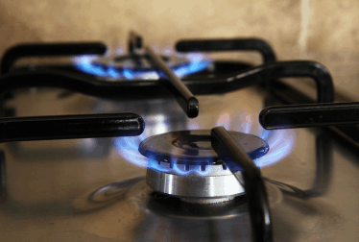
Which GHG?
A
B
C
Burning of Gas
D
Notes:
Burning of Gas (1/2 – QUESTION)
IMAGE ATTRIBUTION
Burning of Natural Gas: Image by PublicDomainPictures from Pixabay (pixabay.com/photos/appliance-burn-burner-cook-cooker-2257/)

Slide 17
Which GHG?
A
B
C
Burning of Gas
D
Notes:
Burning of Gas (2/2 – ANSWER)
IMAGE ATTRIBUTION
Burning of Natural Gas: Image by PublicDomainPictures from Pixabay (pixabay.com/photos/appliance-burn-burner-cook-cooker-2257/)

Slide 18
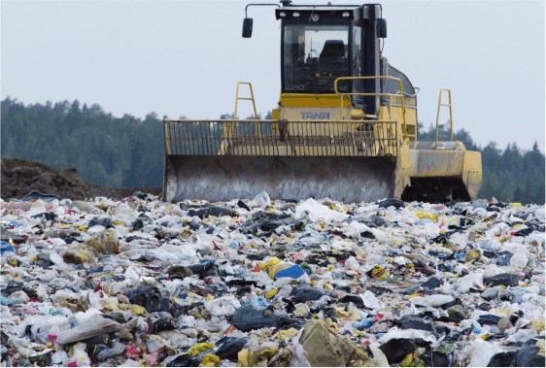
Which GHG?
A
B
C
Landfilling of Waste
D
Notes:
Landfilling of Waste (1/2 – QUESTION)
IMAGE ATTRIBUTION
Landfilling of Waste: Image by Pasi Mäenpää from Pixabay (pixabay.com/photos/landfill-waste-management-waste-879437/)

Slide 19
Which GHG?
A
B
C
Landfilling of Waste
D
Notes:
Landfilling of Waste (2/2 – ANSWER)
IMAGE ATTRIBUTION
Landfilling of Waste: Image by Pasi Mäenpää from Pixabay (pixabay.com/photos/landfill-waste-management-waste-879437/)

Slide 20
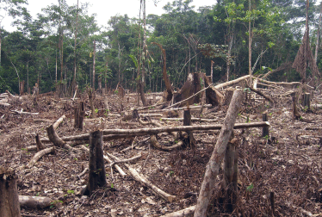
Which GHG?
A
B
C
Land Use Change
D
Notes:
Land Use Change (1/2 – QUESTION)
IMAGE ATTRIBUTION
Land Use Change: Shift cultivation in Columbia from Wikimedia Commons (https://commons.wikimedia.org/wiki/File:Amazon_slash_and_burn_agriculture_Colombia_South_America.jpg). Image by Matt Zimmerman, licensed for reuse under the Creative Commons Attribution 2.0 Generic license (CC BY 2.0) (creativecommons.org/licenses/by/2.0/). No changes made to image.

Slide 21
Which GHG?
A
B
C
Land Use Change
D
Notes:
Land Use Change (2/2 – ANSWER)
IMAGE ATTRIBUTION
Land Use Change: Shift cultivation in Columbia from Wikimedia Commons (https://commons.wikimedia.org/wiki/File:Amazon_slash_and_burn_agriculture_Colombia_South_America.jpg). Image by Matt Zimmerman, licensed for reuse under the Creative Commons Attribution 2.0 Generic license (CC BY 2.0) (creativecommons.org/licenses/by/2.0/). No changes made to image.

Slide 22
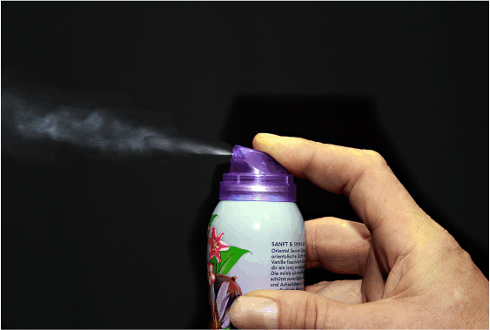
Which GHG?
A
B
C
Aerosol Propellants
D
Notes:
Aerosol Propellants (1/2 – QUESTION)
IMAGE ATTRIBUTION
Aerosol Propellants: Image by 955169 from Pixabay (pixabay.com/photos/fragrance-spray-box-graffiti-night-1502844/).

Slide 23
Which GHG?
A
B
C
Aerosol Propellants
D
Notes:
Aerosol Propellants (2/2 – ANSWER)
IMAGE ATTRIBUTION
Aerosol Propellants: Image by 955169 from Pixabay (pixabay.com/photos/fragrance-spray-box-graffiti-night-1502844/).

Slide 24
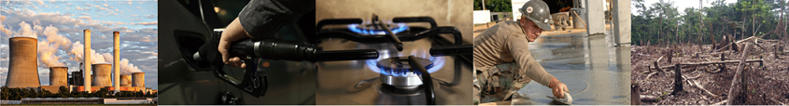
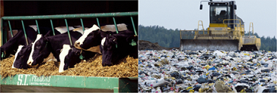
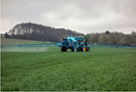
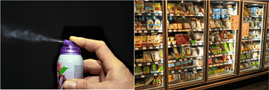
The greenhouse gas sources
Notes:
CORE GHG Sources Activity Feedback 1/1 (ANIMATED SLIDE)
See notes pages on question slides for image attributions.

Slide 25
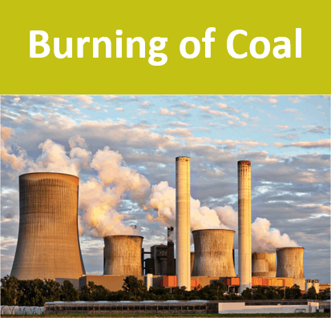
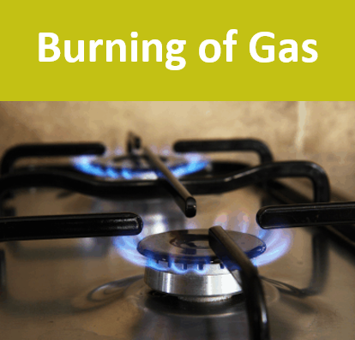

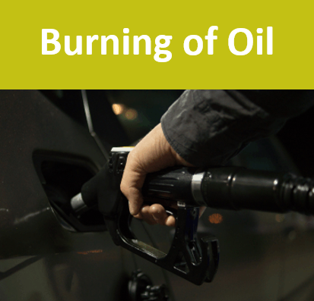

Sources of carbon dioxide (CO₂)
Notes:
EXPANDED GHG Sources Activity Feedback 1/4 – CO₂
By far the most significant source of anthropogenic greenhouse gases, that is greenhouse gas emissions arising from human activities, is the release of carbon dioxide from fossil fuel combustion: the burning of coal and oil and gas.
Carbon dioxide is also produced during cement production in the process of making clinker which is a main ingredient of cement. Limestone (which is calcium carbonate) is heated in a kiln at a very high temperature and it breaks down to form calcium oxide and carbon dioxide.
Fossil fuels and cement production are all fossil sources of carbon dioxide – so in all these cases we’re taking carbon that has been locked up for millions of years in geological reservoirs (be that limestone rocks, or coal seams, or oil and gas fields) and we’re adding it to the atmosphere.
Land use change is a significant secondary source of carbon dioxide. This is when carbon is released from deforestation or land use changes such as draining peatlands or wetlands. Plants and soils store carbon that was fixed from the atmosphere by plants during photosynthesis. When we cut down forests and degrade soils, this carbon is released back to the atmosphere. Sadly this is getting more significant as time goes on – not because we’re managing to decrease fossil emissions, but because global deforestation rates are increasing.
IMAGE ATTRIBUTION
Burning of Natural Gas: Image by PublicDomainPictures from Pixabay (pixabay.com/photos/appliance-burn-burner-cook-cooker-2257/)
Burning of Oil: Image by Rudy and Peter Skitterians from Pixabay (pixabay.com/photos/petrol-gasoline-diesel-gas-996617/)
Burning of Coal: Image by Benita Welter from Pixabay (pixabay.com/photos/power-plant-industry-chimney-2411932/ )
Cement Production: Image by 272447 from Pixabay (pixabay.com/photos/mason-concrete-float-smooth-cement-694271/)
Land Use Change: Shift cultivation in Columbia from Wikimedia Commons (https://commons.wikimedia.org/wiki/File:Amazon_slash_and_burn_agriculture_Colombia_South_America.jpg). Image by Matt Zimmerman, licensed for reuse under the Creative Commons Attribution 2.0 Generic license (CC BY 2.0) (creativecommons.org/licenses/by/2.0/). No changes made to image.

Slide 26
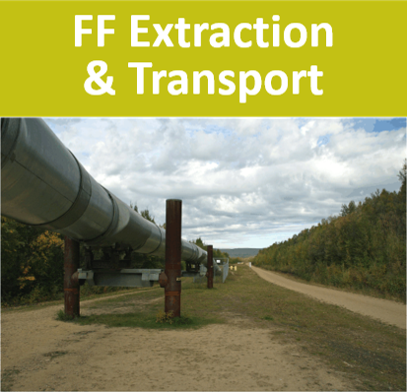



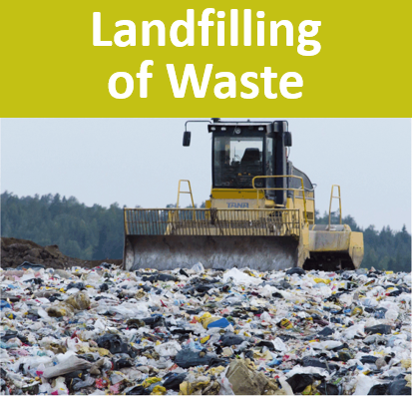

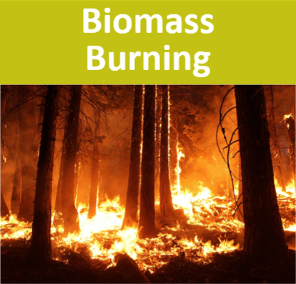
Sources of methane (CH₄)
Notes:
EXPANDED GHG Sources Activity Feedback 2/4 – CH₄
The % of global anthropogenic CH₄ emissions in these notes are from this open access paper: Wang, W., Ren, J., Li, X., Li, H., Li, D., Li, H., & Song, Y. (2020). ‘Enrichment experiment of ventilation air methane (0.5%) by the mechanical tower.’ Scientific Reports, 10, 7276 (11pp). https://doi.org/10.1038/s41598-020-63698-x
First, we should note that fossil fuel combustion also produces some methane – but this is relatively small compared to the amount of carbon dioxide released, and only accounts for around 4% of global methane emissions.
Much more significant for methane is fossil fuel production and transport – which accounts for around one third – or 33% - of global methane emissions. Methane is found associated with any fossil fuel deposit – and when we extract those fossil fuels, invariably some methane will be released. Leakage also occurs during transport – by pipeline or other methods such as shipping - where this is referred to as fugitive (or escaping) emissions.
Collectively, the main source of anthropogenic methane is agriculture, which accounts for around 42% of global emissions and is dominated by livestock production – and specifically ruminant animals.
A ruminant is any animal that chews the cud – so cattle, sheep, goats, deer, and camels are all ruminants. Ruminants have very different digestive systems to ours – with four stomach compartments. Their first stomach, called a rumen, is packed full of microbes that breakdown the cud in a process known as enteric fermentation, where this happens under anaerobic conditions – that is low or no oxygen conditions. Whenever biomass (that’s organic material that comes from plants and animals) is broken down under low oxygen conditions, some methane will be produced.
Indeed, this is what is happening in all our other sources of methane…
So if we look at our other agricultural sources of methane…
In manure management - anaerobic conditions often occur where manure is stored in large piles or settlement ponds – so the microbes breaking down the manure will produce methane.
Likewise, in rice paddies – the waterlogged soils are anaerobic – so the microbes in paddy field soils will produce methane
We also see the same microbial processes happening in the management of human wastes – in both landfilling and in wastewater treatment, where anaerobic breakdown of organic matter leads to methane emissions. This accounts for around 18% of global emissions.
Our last source of methane is biomass burning – which accounts for around 3% of emissions. This includes crop residue burning, forest fires (resulting from both natural and human activities), and prescribed savannah, pasture, and cropland burning. It also includes emissions from household biomass stoves. While complete combustion would only produce water vapour and CO₂, when you get incomplete combustion, other gases like methane are also produced. This happens in smouldering combustion, so lower temperature flameless fires, which are less efficient than flaming combustion, but can also happen in large out of control flaming fires when there isn’t enough oxygen to ensure complete combustion.
IMAGE ATTRIBUTION
Fossil Fuel Extraction & Transport: Image by David Mark from Pixabay (pixabay.com/photos/alaska-alaska-pipeline-oil-67304/)
Ruminant Livestock: Image by 272447 from Pixabay (pixabay.com/photos/cows-cattle-dairy-holstein-farm-526771/)
Manure Management: Image by Benjamin Brandt from Pixabay (pixabay.com/photos/crap-agriculture-fertilize-609771/)
Rice Paddies: Image by Pexels from Pixabay (pixabay.com/photos/beautiful-cottage-rice-field-1866498/)
Landfilling of Waste: Image by Pasi Mäenpää from Pixabay (pixabay.com/photos/landfill-waste-management-waste-879437/)
Wastewater Treatment: Benfleet Sewage Treatment Plant: Primary Settling Tanks from geograph.org.uk (geograph.org.uk/photo/1450088). © Copyright John Rostron, licensed for reuse under the Creative Commons Attribution-Share Alike 2.0 Generic license (CC BY-SA 2.0) (creativecommons.org/licenses/by-sa/2.0/). No changes made to image.
Biomass Burning: Image by 272447 from Pixabay (pixabay.com/photos/wildfire-forest-fire-blaze-smoke-1105209/)

Slide 27

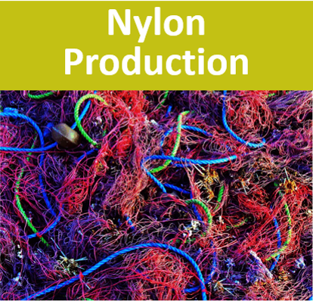
Sources of nitrous oxide (N₂O)
Notes:
EXPANDED GHG Sources Activity Feedback 3/4 – N₂O
The % of global anthropogenic N₂O emissions in these notes are from the following open access paper and report:
Davidson, E.A., Kanter, D. (2014). ‘Inventories and scenarios of nitrous oxide emissions.’ Environmental Research Letters, 9(10), 105012 (12pp). https://doi.org/10.1088/1748-9326/9/10/105012
UNEP (2013). Drawing Down N₂O to Protect Climate and the Ozone Layer: A UNEP Synthesis Report. https://wedocs.unep.org/handle/20.500.11822/8489
As with methane, fossil fuel combustion will result in some emissions of nitrous oxide – again these emissions are relatively small compared to the amount of carbon dioxide released – although they do account for around 10% of nitrous oxide emissions.
Indeed, any combustion process will result in some nitrous oxide emissions, and so biomass burning is also a source of nitrous oxide – accounting for around 11% of global emissions.
Also like methane, agriculture is our main source of nitrous oxide – accounting for around two-thirds (or 66%) of total emissions. This is dominated by the use of nitrogen based fertilisers and applying manure (a nitrogen rich material) to soils, with some additional emissions from manure management. Here, the nitrogen in the fertiliser or the muck stimulates the microbial nitrogen cycle to produce nitrous oxide.
As with animal manure, human sewage is also a nitrogen rich material – and so wastewater management also produces nitrous oxide.
In addition to fossil fuel combustion there are other industrial sources of nitrous oxide. The two most significant are adipic and nitric acid production – which account for around 5% of global emissions. Adipic acid is used in the manufacture of synthetic fibres like nylon. Nitric acid is used in a number of processes, including the manufacture of N based fertilisers and explosives.
IMAGE ATTRIBUTION
Fertilisers: Image by Franck Barske from Pixabay (pixabay.com/photos/tractor-fertilizer-pesticide-spray-4217686/)
Manure Management: Image by Benjamin Brandt from Pixabay (pixabay.com/photos/crap-agriculture-fertilize-609771/)
Wastewater Treatment: Benfleet Sewage Treatment Plant: Primary Settling Tanks from geograph.org.uk (geograph.org.uk/photo/1450088). © Copyright John Rostron, licensed for reuse under the Creative Commons Attribution-Share Alike 2.0 Generic license (CC BY-SA 2.0) (creativecommons.org/licenses/by-sa/2.0/). No changes made to image.
Nylon Production: Public domain image from PxHere (pxhere.com/en/photo/675499)
Biomass Burning: Image by 272447 from Pixabay (pixabay.com/photos/wildfire-forest-fire-blaze-smoke-1105209/)

Slide 28
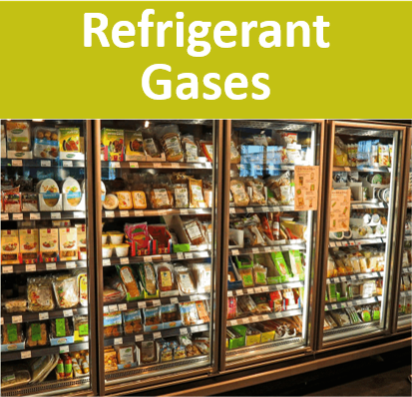

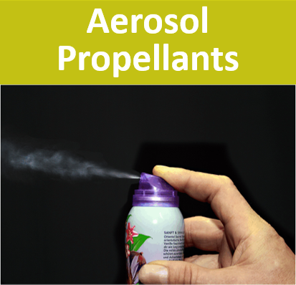
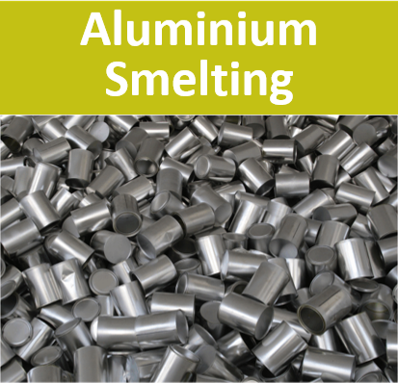


Sources of F-gases
Notes:
EXPANDED GHG Sources Activity Feedback 4/4 – F gases
The F gases are man-made chemicals – so their only sources are industrial - and their emissions are associated with a wide range of different applications and processes. Many of them were produced as replacements for the chlorofluorocarbons – or CFCs – when they were banned under the Montreal Protocol on Ozone Depleting Substances
HFCs – the hydrofluorocarbons - are used as aerosol propellants, as refrigeration gases in fridges, freezers and air conditioning systems, and as fire-fighting agents.
PFCs – the perfluorocarbons – are produced during primary (or new) aluminium smelting, where you don’t get these emissions from secondary (recycled) aluminium.
PFCs are also used as etching gases and cleaning agents in semiconductor manufacture.
Finally, the F-gas sulphur hexafluoride, is used as an electrical insulator to prevent arcing and electrical fires in high voltage gas insulated switchgear like electricity substations (it is inside the white tubes you can see in the picture).
IMAGE ATTRIBUTION
Refrigerant Gases: Image by Kevin Phillips from Pixabay (pixabay.com/photos/supermarket-fridge-produce-food-949912/).
Aerosol Propellants: Image by 955169 from Pixabay (pixabay.com/photos/fragrance-spray-box-graffiti-night-1502844/).
Firefighting Agents: Image by chitsu san from Pixabay (pixabay.com/photos/fire-fighting-fire-extinguisher-302586/)
Aluminium Smelting: Image by ziodanilo from Pixabay (pixabay.com/photos/cans-texture-aluminum-2542942/)
Semiconductor Manufacture: Image by Republica from Pixabay (pixabay.com/photos/main-board-chips-electronics-89050/)
Electrical Insulator: Sulphur hexafluoride gas circuit breakers in a 420 kV switchyard from Wikimedia Commons (commons.wikimedia.org/wiki/File:GIS_420kV.jpg). Image by Dingy, licensed for reuse under the Creative Commons Attribution-Share Alike 3.0 Unported license (CC BY-SA 3.0) (https://creativecommons.org/licenses/by-sa/3.0/deed.en). No changes made to image.

Slide 29

GHG Emissions by Sector
Agriculture
5,796 MtCO₂e (12%)
Energy accounts for 73%
of global GHG emissions
LUCF
3,217 MtCO₂e (7%)
Electricity & Heat
15,005 MtCO₂e (30%)
Industrial Processes
2,771 MtCO₂e (6%)
Waste
1,561 MtCO₂e (3%)
Other Fuel
1,429 MtCO₂e (3%)
Buildings
2,721 MtCO₂e (6%)
Fugitive
2,883 MtCO₂e (6%)
Transportation
7,866 MtCO₂e (16%)
Manufacturing
& Construction
6,109 MtCO₂e (12%)
Notes:
OPTIONAL SUMMARY 1/3 - Breakdown of emissions by sector (all gases expressed as CO₂e)
This pie-chart provides a breakdown of emissions by sector. All the “hot” colours (yellow-red) represent energy related emissions – so we can see our use of energy accounts for nearly three-quarters of global GHG emissions.
Data Source: The data presented here is the 2016 Global (World) emissions (including Land Use Change and excluding Bunker Fuels) from the World Resources Institute CAIT Climate Data Explorer – Historical Emissions – Country GHG Emissions dataset:
http://cait.wri.org/historic

Slide 30
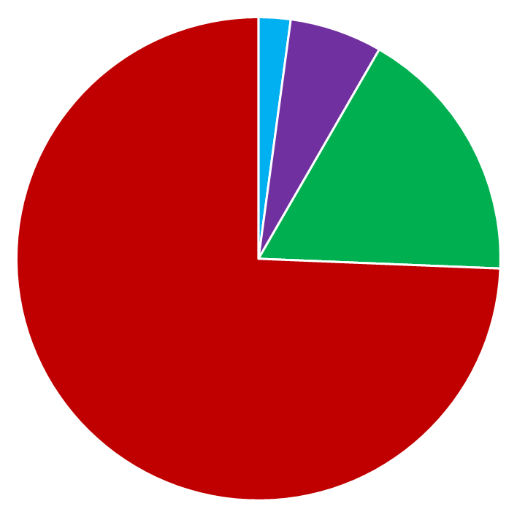
GHG Emissions by Gas
CO₂ accounts for 74%
of global GHG emissions
F-gases
1,054 MtCO₂e
(2%)
CO₂
36,700 MtCO₂e
(74%)
N₂O
3,054 MtCO₂e
(6%)
CH₄
8,550 MtCO₂e
(17%)
carbon dioxide
methane
nitrous oxide
F-gases
Notes:
OPTIONAL SUMMARY 2/3 - Breakdown of emissions by gas
This pie chart shows a breakdown of global emissions by gas – with emissions of each gas presented as carbon dioxide equivalents. We can see that the dominant anthropogenic greenhouse gas is carbon dioxide, which accounts for nearly three-quarters of total emissions.
Data Source: The data presented here is the 2016 Global (World) emissions (including Land Use Change and excluding Bunker Fuels) from the World Resources Institute CAIT Climate Data Explorer – Historical Emissions – Country GHG Emissions dataset:
http://cait.wri.org/historic

Slide 31





GHG Emissions by Sector & Gas
Industrial
Processes
2,771 MtCO₂e
(6%)
Energy
36,014 MtCO₂e
(73%)
Agriculture
5,796 MtCO₂e
(12%)
Waste
1,561 MtCO₂e
(3%)
LUCF
3,217 MtCO₂e
(7%)
carbon dioxide
methane
nitrous oxide
F-gases
Notes:
OPTIONAL SUMMARY 3/3 - Breakdown of emissions by sector and gas
This slides provides a breakdown by sector and gas. The size (area) of the pie-charts is scaled to reflect the total emissions from each sector. “Energy” and “Land Use Change and Forestry” are dominated by carbon dioxide, with smaller amounts of methane and nitrous oxide. “Industry” has the man-made F-gases added in. “Agriculture” and “waste management” (solid waste and wastewater) are dominated by methane and nitrous oxide.
Data Source: The data presented here is the 2016 Global (World) emissions (including Land Use Change and excluding Bunker Fuels) from the World Resources Institute CAIT Climate Data Explorer – Historical Emissions – Country GHG Emissions dataset:
http://cait.wri.org/historic

