Slide 1

Responsible Futures
INSERT NAME
INSERT JOB TITLE

Slide 2
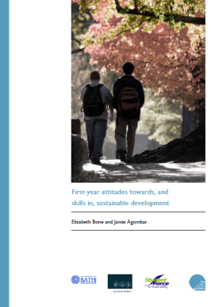
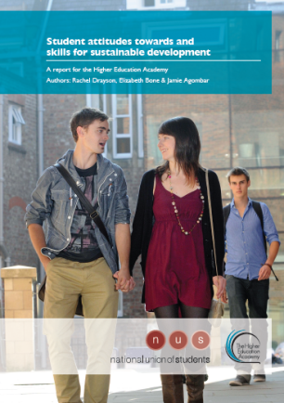
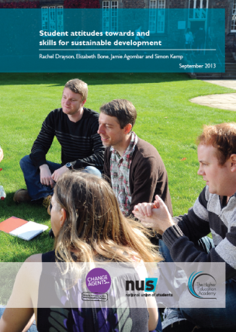
NUS HEA surveys:
A latent student interest in sustainability
Notes:
But do students care about sustainability?
Over the last 4 years, we have conducted large-scale research with the HEA (higher education academy) on student attitudes to sustainability. The findings show that:
- 2/3 students said they want to learn more about sustainability
- 80% believe sustainable development is something which universities should actively incorporate and promote
- 2/3 said they would willingly get paid £1000 less a year, if the company they worked for had a good environmental and ethical record.
(latest year was 7000 students)
Students want to engage with this agenda and gain vital employability skills for their future careers.

Slide 3
How is ESD defined in Higher Education?
Education for sustainable development is the process of equipping students with the knowledge and understanding, skills and attributes needed to work and live in a way that safeguards environmental, social and economic wellbeing, both in the present and for future generations.
QAA ESD guidance 2014

Slide 4
What does that mean for students?
Consider what the concept of global citizenship means in the context of their own discipline and in their future professional and personal lives
Democratic and participatory learning approaches are modelled. Teaching, learning and assessment activities are linked to real-life concerns.
Think about issues of social justice, ethics and wellbeing, and how these relate to ecological and economic factors
Develop a future-facing outlook, learning to think about the consequences of actions, and how systems and societies can be adapted to ensure sustainable futures.

Slide 5
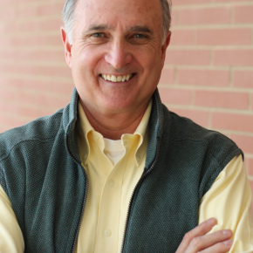
Why tertiary education?
“It is worth noting that the destruction of the planet is not the work of ignorant people. Rather it is largely the results of work by people with BAs, BScs, LLBs, MBAs, and PhDs …Education can equip people to be more effective vandals of the earth.”
David Orr
Notes:
But why should we engage students in particular?
The professor David Orr states that the destruction of the planet is not the work of ignorant people. It’s the actions of extremely well-qualified people who have been through our education system. Education can equip people to be more effective vandals of the earth.

Slide 6
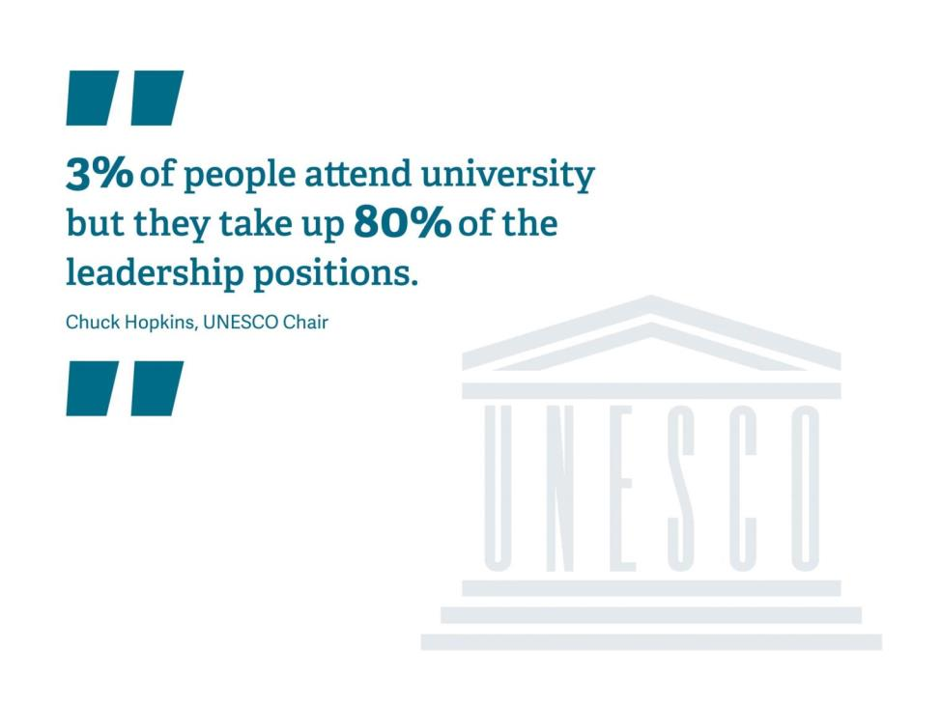

Slide 7

Responsible Futures
The vision for Responsible Futures is of a desirable, externally assessed accreditation mark for a whole-institution approach to environmental sustainability and social responsibility, spanning the formal and informal curriculum, applicable to both further and higher education.
Piloted in 2014-15 within 13 institutions, 8 HE and 5 FE across England and Scotland.
Notes:
PILOT INSTITUTIONS
Coventry University
Dumfries and Galloway College
Edinburgh University
Keele University
Manchester Metropolitan University
Sheffield College
South Lanarkshire College
SRUC –Scotland’s Rural College
University of Bristol
University of Chester
University of Plymouth
University of Worcester
South Thames College

Slide 8
Aims
Engaging students’ unions on ESD
Developing new collaborative partnerships
Building leadership and strategic capacity
Securing high-level policy commitments
Improving knowledge and understanding
Legitimising and mainstreaming ESD
Advancing ESD in the formal and informal curriculum

Slide 9


Process
Workbook of criteria outlining best practice, must reach score threshold
Supported cohort approach, regular contact, online resource bank
Student-led audit and programme review
Continuous improvement, student-driven change

Slide 10
Impacts
400 actions taken by the 2014/15 cohort, including:
Conducting student surveys;
Completing a curriculum audit/review;
Including ESD in the institution’s learning and teaching strategy;
Developing professional development opportunities for staff;
Gaining support of senior management, trustees, and/or governors;
Offering interdisciplinary experiences related to sustainability.
Notes:
400 actions completed by the 13 partnerships:
Conducted a survey of students;
Created a coordinating group;
Developed a SMART action plan with senior-level support;
Gained the support of high-level champions within both the students’ union and the university/college;
Included education for sustainable development within the institution’s learning and teaching strategy;
Developed professional development opportunities for relevant personnel on the issues covered by Responsible Futures;
Held an internal event bringing together staff and students;
Made use of student coursework;
Developed informal curriculum activities.
Other impacts delivered by the pilot cohort include:
10 completed a curriculum audit/review;
11 engaged with their trustees and/or governors to gain high-level support;
8 embedded sustainability within their institutions’ learner attributes;
9 students’ unions passed formal policy;
8 institutions created ‘living laboratories’;
9 institutions offer interdisciplinary experiences relating to sustainability through the formal curriculum.

Slide 11
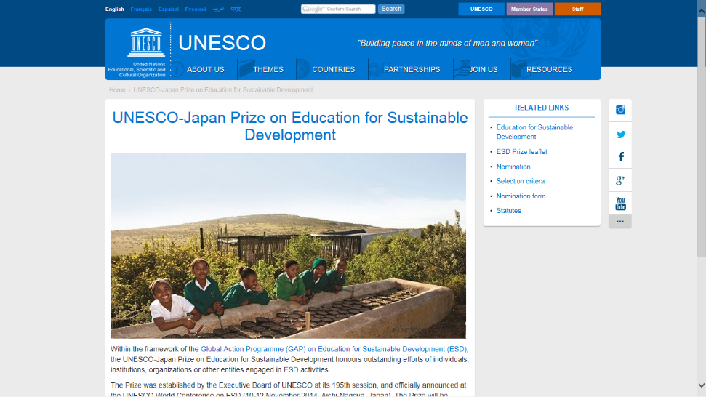

Slide 12
Key factors for change
Students leading the way and providing them with space to do so and ownership
Equipping students with the necessary skills
Not just knowledge but also attributes
Developing critical thinkers and agents of change
Connecting the student experience and ensuring a holistic journey

Slide 14

Thank you!
INSERT NAME
INSERT EMAIL

